Slide 1


WELCOME TO
HERTZ CUSTOMER COMMUNICATION
Fatma Alsagaf – Learning & Development Manager
Notes:
.

Slide 2











HOUSEKEEPING

Slide 3

COURSE OBJECTIVES
What are your course objectives?
What are our course objectives?
By the end of this course, you will be able to:
Explain the communication process and its key stages.
Identify and address communication barriers that affect clarity and understanding.
Communicate confidently and professionally across various channels.
Use active listening and questioning to identify customer needs.
Apply DISC profiling to adapt to customer communication styles.
Tailor communication to different customer personas for better satisfaction.

Slide 4
AGENDA
Welcome & Introduction
Hertz Process
Effective Communication
Mastering Verbal Communication
Mastering Non-verbal Communication
Active Listening Techniques
Effective Questioning Techniques
Digital Communication
Customer Profiling

Slide 5
1
SECTION
HERTZ PRODUCTS & PROCESS

Slide 6



ACTIVITY 1: WHAT ARE THE 6 STAGES OF THE HERTZ PROCESS
Flip Chart Exercise
OPEN DISCUSSION
5 mins

Slide 7
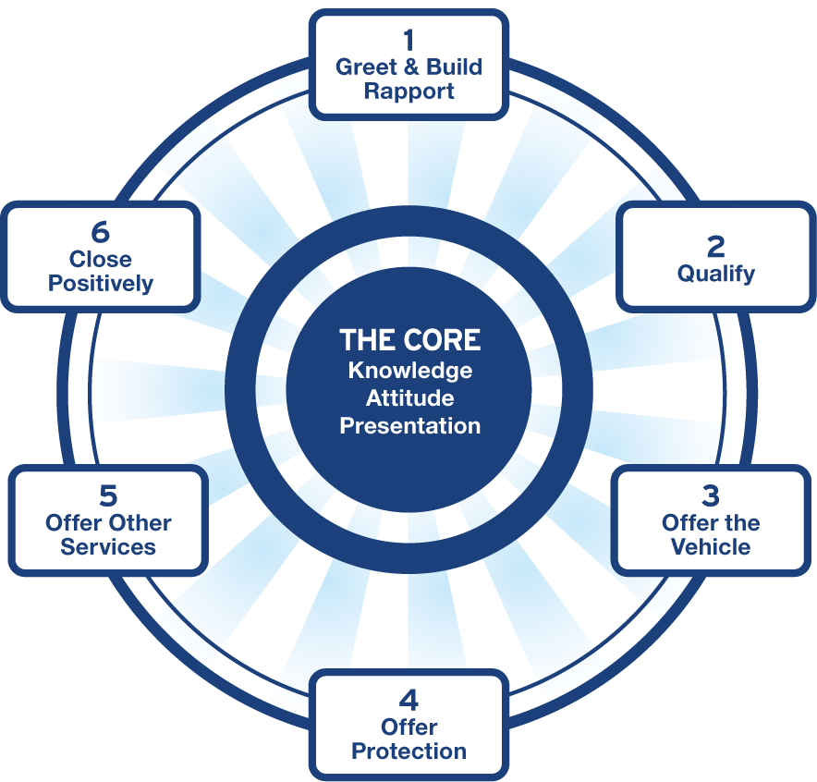
Service Based Sales Process
COMMUNICATION

Slide 8
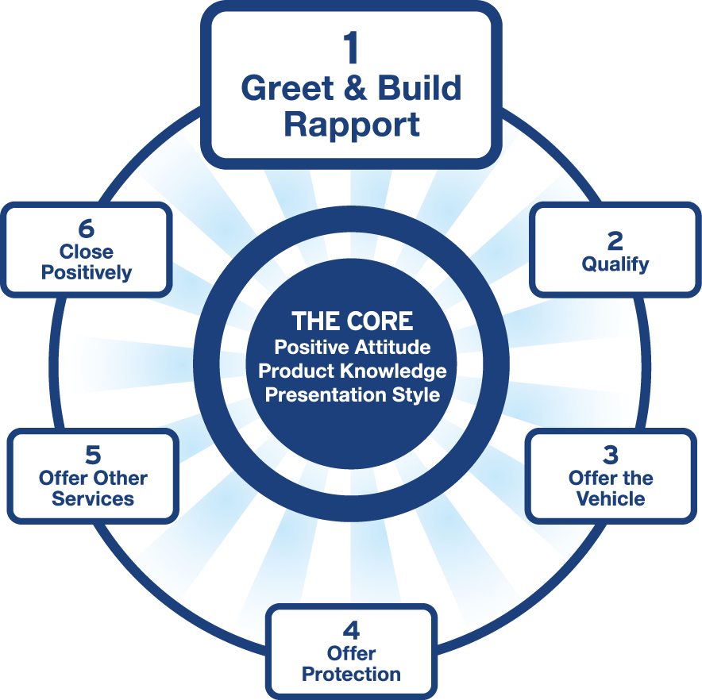
Step 1: Greet and Build Rapport
Knowledge Customer Delight Presentation

Slide 9

Step 1: Greet and Build Rapport
The Importance Of The First Meeting:
Establishes lasting first impressions.
Represents yourself, dealership, and experience.
Prioritizes customer comfort.
Builds trust and rapport.

Slide 10




Step 1: Greet and Build Rapport
Key Elements of a Successful Greeting:
1
2
3
4
PROFESSIONAL APPEARANCE
WARM INTRODUCTION
PROVIDE ASSISTANCE
SET CLEAR EXPECTATIONS

Slide 11
Step 1: Greet and Build Rapport
Key Elements of a Successful Greeting:
1
PROFESSIONAL APPEARANCE
2
3
4
Personal hygiene.
Smile warmly.
Positive body language.
WARM INTRODUCTION
PROVIDE ASSISTANCE
SET CLEAR EXPECTATIONS

Slide 12

Step 1: Greet and Build Rapport
Key Elements of a Successful Greeting:
2
WARM INTRODUCTION
1
Meet the customer within 3
mins.
Introduction of name and job title.
Express gratitude.
Offer a beverage.
Ask about online exploration.
Maintain a friendliness.
3
4
PROFESSIONAL APPEARANCE
PROVIDE ASSISTANCE
SET CLEAR EXPECTATIONS

Slide 13
Step 1: Greet and Build Rapport
Key Elements of a Successful Greeting:
3
PROVIDE ASSISTANCE
1
2
4
Ask open-ended questions.
Listen actively to their needs.
Share helpful resources.
Mirror their personality
traits
PROFESSIONAL APPEARANCE
WARM INTRODUCTION
SET CLEAR EXPECTATIONS

Slide 14
Step 1: Greet and Build Rapport
Key Elements of a Successful Greeting:
4
SET CLEAR EXPECTATIONS
1
2
3
Explain the process briefly.
Mention potential outcomes.
Invite questions for clarity.
PROFESSIONAL APPEARANCE
INTRODUCTION STATEMENT
PROVIDE ASSISTANCE

Slide 15
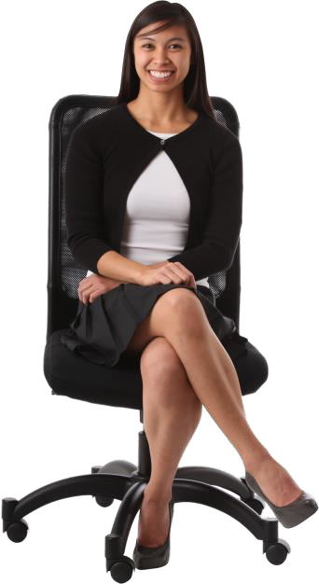

Service Standards
S M I L
E
START WITH A WARM GREETING
Welcome every customer with a friendly and professional greeting. Use their name if possible to personalize the interaction.
MAKE EYE CONTACT
Maintain pleasant eye contact during interactions to show attentiveness and respect.
INTRODUCE YOURSELF & OFFER ASSISTANCE
Introduce yourself by name and role. Offer assistance proactively, such as guiding them through the rental process or answering any questions.
LISTEN ACTIVELY
Listen carefully to
EMPATHIZE WITH CUSTOMERS
Show empathy towards
customers' needs and concerns. Ensure you understand their preferences and requirements, and respond appropriately.
customers by understanding their situation, whether they are in a hurry, stressed, or excited about their trip. Acknowledge their feelings and offer solutions.

Slide 16
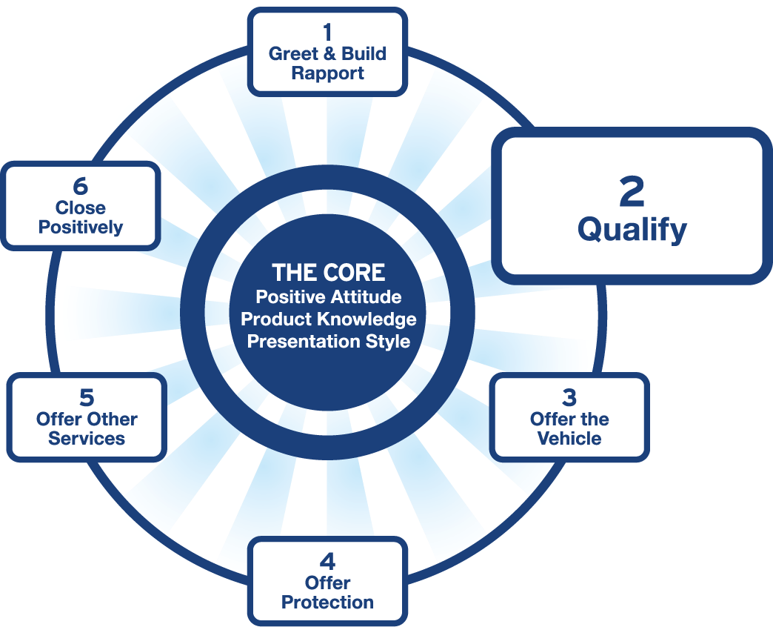
Step 2: Qualification
Knowledge Customer Delight Presentation

Slide 17
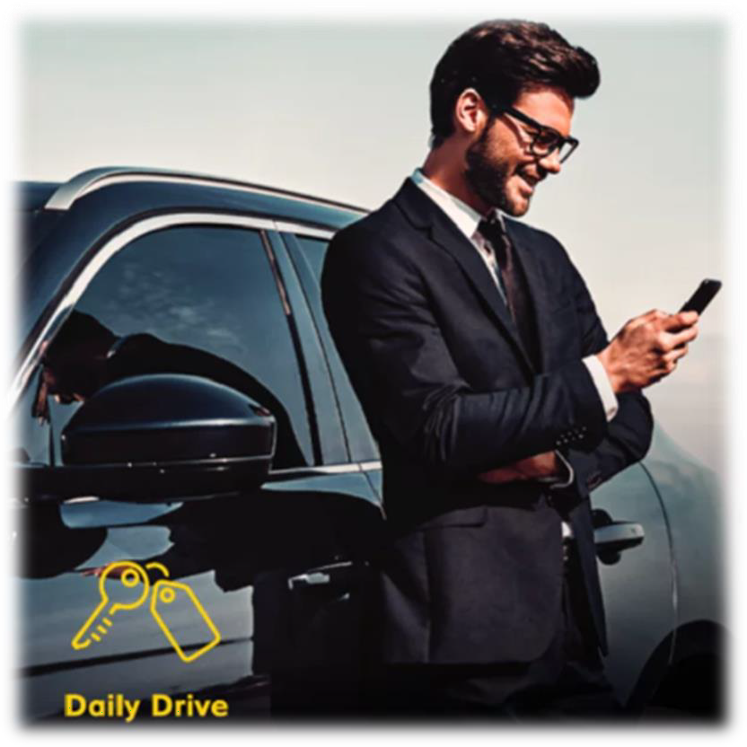
Step 2: Qualification
THE OBJECTIVES OF QUALIFICATION
Increase customer satisfaction by giving the customer a
professional experience
Effectively qualify customers to match them with the ideal vehicle
Recognize the effect your attitude has on your customer
Develop a climate of trust and understanding with different customers

Slide 18


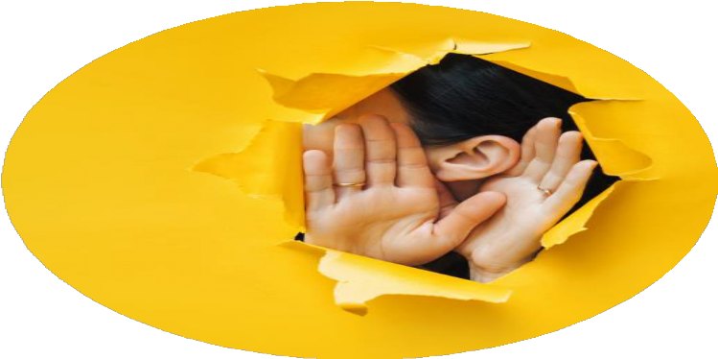
Step 2: Qualification
How can we get that information?
Asking Questions
Active Listening
Observing

Slide 19
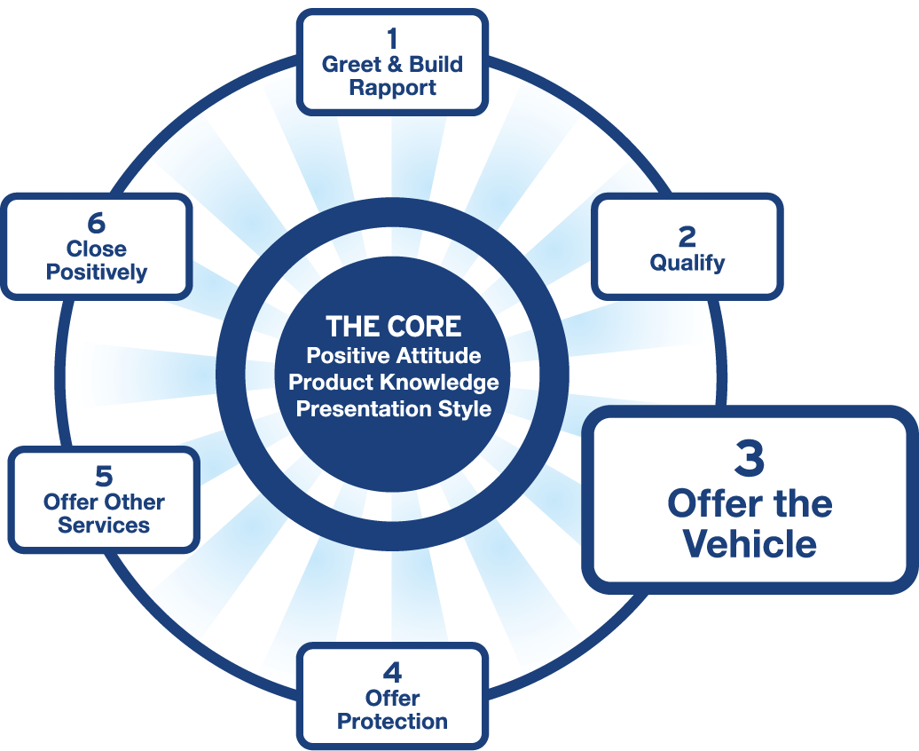
Step 3: Offer the Vehicle
Knowledge Customer Delight Presentation

Slide 20
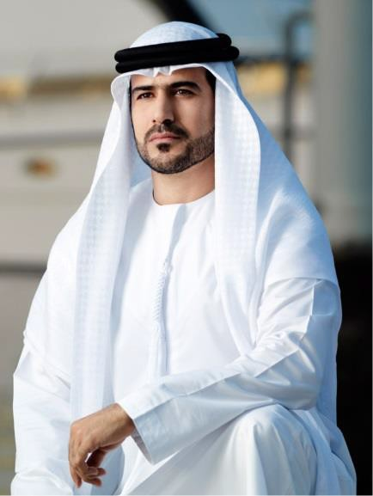


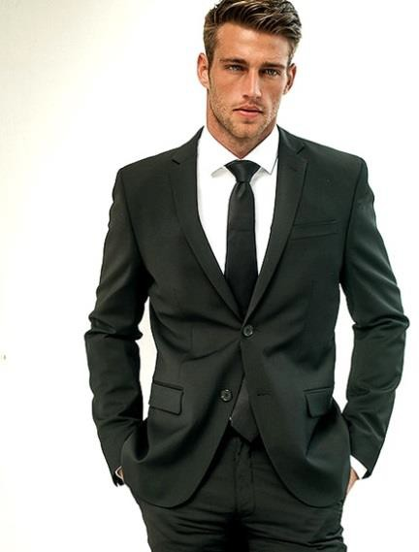
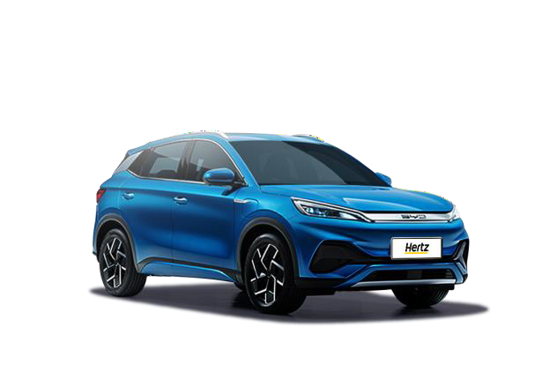
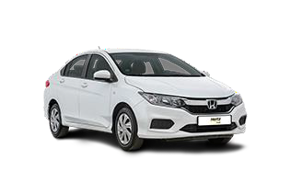

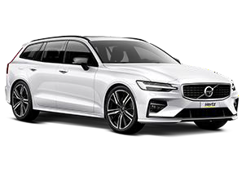

Step 3: Offer the vehicle
Match the car to the right customer

Slide 21
Step 3: Offer the vehicle
Important reminder when Upselling
Never pre-judge customers
Be consistent
Avoid negative words of their reserved car
Become an expert on specific features

Slide 22




Step 3: Offer the vehicle
Matching Features and Benefits to customer profile
What comes to mind?
Knowing that the customer will be doing a lot of driving can tell you…
Knowing how many passengers and how much luggage can tell you…
Knowing the type of vehicle the customer normally drives can tell you...
Knowing the customer is in a hurry or asking about return procedures/hours can tell you…

Slide 23






CUSTOMERS RENTAL MOTIVATION
The SPECIT Method
S
P
E
C
I
T
Safety & Security
Performance
Environment, Economy, Electrification
Comfort & Convenience
Image
Technology
Automotive Division
80

Slide 24
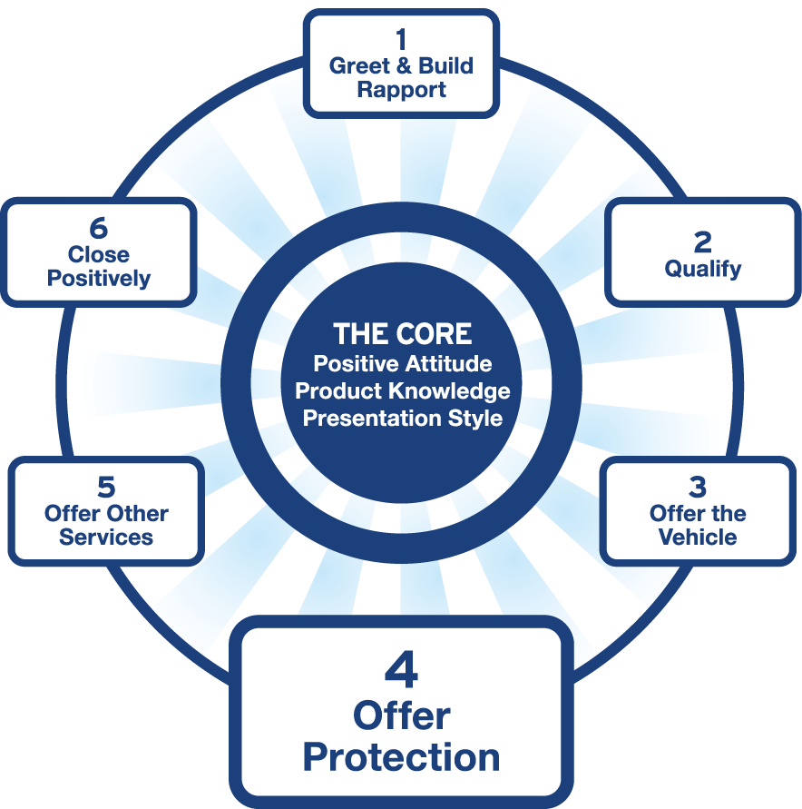
Step 4: Offer Protection
Knowledge Customer Delight Presentation

Slide 25
Step 4: Offer Protection
Yes to Benefits – Not Consequences
Focus on the positives not negatives
Give customers the opportunity to make informed buying decision
Customers are more receptive to your presentation will be much more likely to say yes
Experts educate and deliver exceptional service

Slide 26
Step 4: Offer Protection
Protection Guidelines
Offer Premium Protection Package first - Top Down Sell
Explain benefits before price …to show value
Be prepared for objection
Remain positive; do not challenge or confront the customer

Slide 27
Step 4: Offer Protection
The Offer
Customer Focused Offer:
“I recommend our Premium Protection Package.”
“You did want our Premium Protection Package.”
Prohibited Dialogue:
Offering individual products rather than package.
Asking for acceptance rather than stating.
“Did you want the full protection?”
“Do you want coverage?”

Slide 28
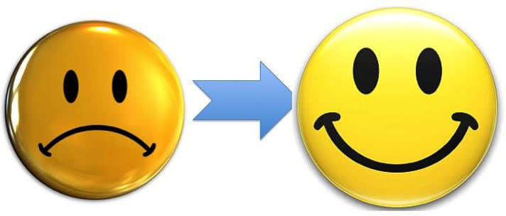
Step 4: Offer Protection
Dealing with Customer Objections
Acknowledge Probe Answer Confirm

Slide 29
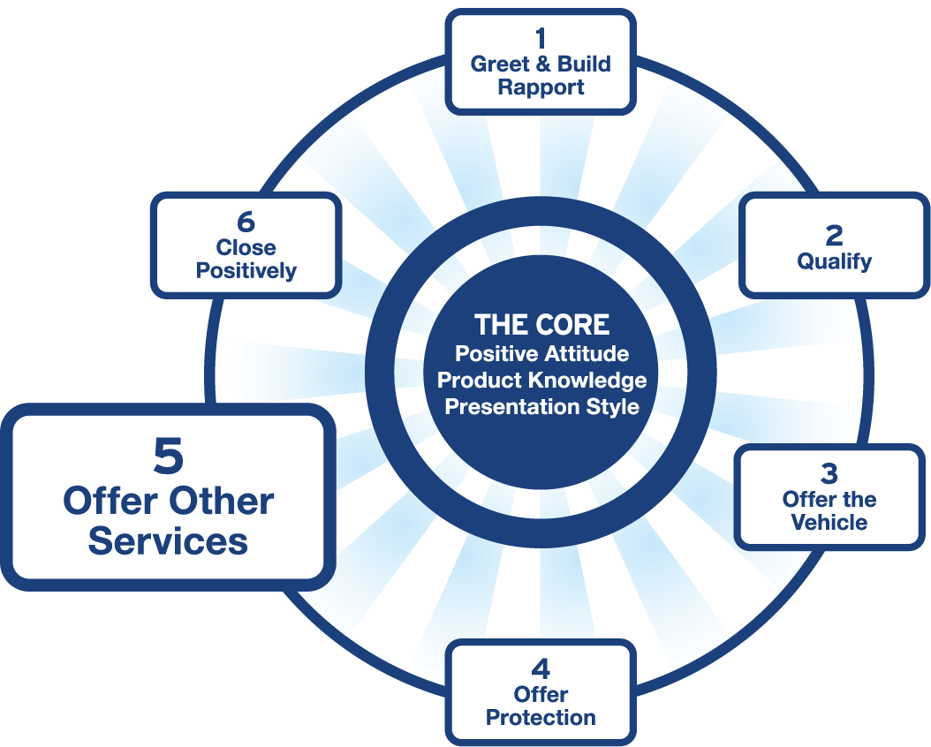
Step 5: Offer Other Services
Knowledge Customer Delight Presentation

Slide 30
Step 5: Offer Other Services
Fuel Options
Example:
“So that you don’t have to stop at the gas station on your way to return the car, for your convenience, I recommend the Fuel Purchase Option with your rental. You buy the tank now and return it without refueling.”
Benefits
Saves time
Put it on one receipt
Convenient
Money value
Refueling service
Emphasize convenience, not as a penalty

Slide 31
Step 5: Offer Other Services
Additional Services
Be Assumptive:
Additional drivers
“How many drivers will there be?”
Navigation system (GPS)
Child Seats
“How many child seats will you need?”

Slide 32
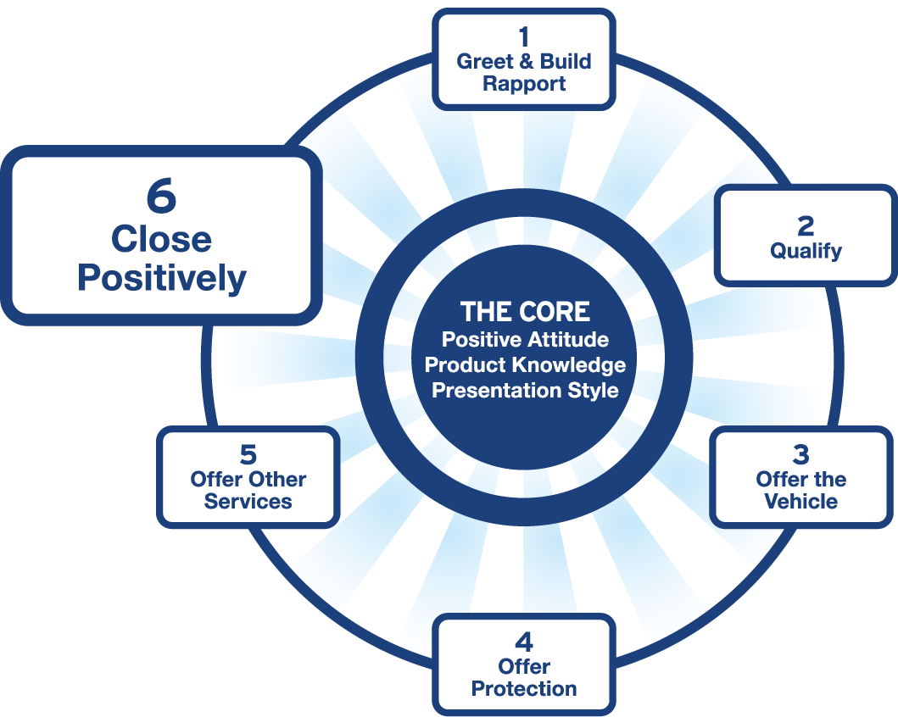
Step 6: Close Positively
Knowledge Customer Delight Presentation

Slide 33

Step 6: Close Positively
Use confidence and control
Give clear and concise explanations
Be prepared to explain all charges: T&B
Be confident in overcoming any last minute objections
People most often remember the last thing they heard.

Slide 34
Service Based Sales Process
What is at the core of all stages?
COMMUNICATION

Slide 35
2
SECTION
EFFECTIVE COMMUNICATION

Slide 36

COMMUNICATION
What is communication?
A sharing of information, thoughts, feelings, ideas through a language
Notes:
Start with a question: “What does communication mean to you?”
Highlight that communication is not limited to just words — it’s a multi-layered process involving thoughts, emotions, and context.
Emphasize that the word "language" includes body language, tone, and visuals — not just spoken or written words.
Link it to real-life context: “In our daily roles, how often do we focus on what we’re saying, but forget how we’re saying it?”

Slide 37
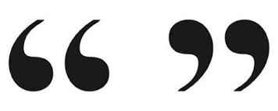
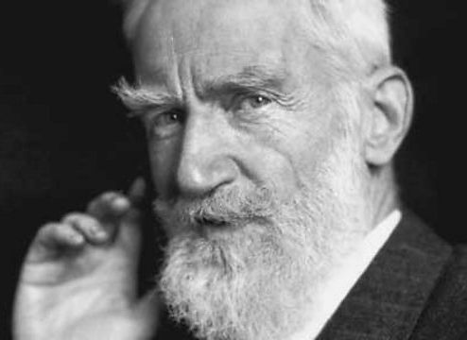
COMMUNICATION
The single biggest problem in communication is the illusion that it has taken place.
- George Bernard Shaw
Notes:
George Bernard Shaw, known at his insistence as Bernard Shaw, was an Irish playwright, critic, polemicist and political activist. His influence on Western theatre, culture and politics extended from the 1880s to his death and beyond.
Read the quote and pause.
Ask participants: “Have you ever left a conversation thinking you were clear, but the other person completely misunderstood?”
Emphasize that effective communication is not what’s said but what’s understood.
Transition: “That brings us to the importance of clarity and confirmation in our interactions.”

Slide 38
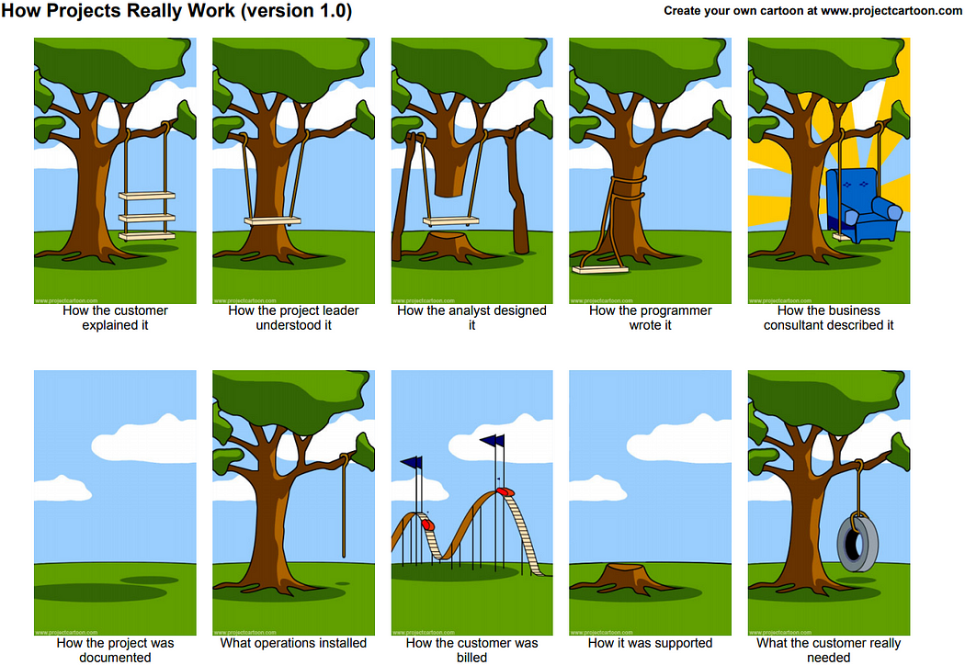
COMMUNICATION
Notes:
Walk through each frame briefly, narrating with exaggerated expressions to highlight miscommunication.
Frame 1: “How the customer explained it” → exaggerated misunderstanding.
Frame 2: “How the project leader understood it” → assumption.
Frame 3–10: Keep participants laughing but thoughtful—each image reveals the cost of miscommunication.
Debrief: “What went wrong here? Where was the breakdown? Is this too far from our own customer interactions?”
Key Message: Everyone interprets communication through their own lens. Without clear, two-way understanding, misalignment is inevitable.

Slide 39

COMMUNICATION
Basic Need in Communication:
Need to be heard
Need to be felt
Need to be understood
Notes:
Say: “Beyond just solving problems, these are the core emotional needs in any conversation.”
Ask: “When a customer gets upset, what are they really asking for?”
Explain each:
Heard: They want to be listened to without interruption.
Felt: They want their emotions to be acknowledged.
Understood: They want validation that their situation makes sense.
These are key to building connection before offering a solution.

Slide 40
COMMUNICATION
Effective Communication means…
a 2-way process of sharing information, thoughts, feelings, ideas so that results can be achieved.
Notes:
Contrast with Slide 1: This moves from "what" to "how well."
Say: “What’s the difference between just sending a message and ensuring it lands well?”
Introduce the concept of two-way communication: “Communication is only complete when the other person receives and responds.”
Give example: “You explain a feature to a customer. If they nod, does it mean they understood? Not necessarily. That’s why feedback and active checking are key.”

Slide 41
COMMUNICATION
Benefits of effective communication
Quicker problem solving
Better decision making
Steady work flow
Strong business relations
Better professional image
Notes:
Ask: “Which one of these benefits has the biggest impact in your day-to-day role?”
Give a real example for each:
Quicker problem solving → misunderstandings don’t drag out.
Better decisions → when all sides are heard, outcomes improve.
Steady workflow → fewer errors, less rework.
Stronger relationships → internally and with customers.
Professional image → clear communicators earn more trust.
Transition smoothly: “To achieve all of this, we need to understand the process of communication… but before we do that let us do an activity

Slide 42
ACTIVITY 2: Describe It - Draw It
One participant will describe an image while the others draws it based solely on the verbal description
Group
3mins per picture
Notes:
This activity is a fun way to demonstrate how important it is to communicate clearly.
Instruction
The participant describing should face away from the delegates
No showing the picture.
No one can ask any questions so everyone can hear clearly
Materials Needed:
Timer to time the activity
1 blank sheet of paper for each delegate to draw
Drawing Pencil
• Print Shapes Pages (included)-
There are 9 shapes/images. You can do more than 1 round.
Debrief (after the laughs):
“How many of your drawings looked like the original?”
“What made the communication easier or harder?”
“What assumptions did you make as the Describer or the Drawer?”
“How does this relate to communication with our customers?”
Key Talking Points:
Even simple messages get lost if assumptions, unclear language, or missing feedback loops exist.
In real communication, we need clarity, checking for understanding, and adjusting based on the listener’s perspective.
This connects to what we’ll explore next: the process and types of communication—and how to master both verbal and non-verbal cues.

Slide 43


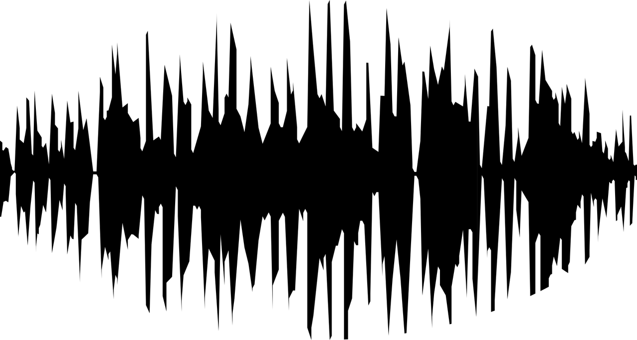
THE COMMUNICATION PROCESS
How Communication Works
SENDER
RECEIVER
CHANNEL
MESSAGE
ENCODING
DECODING
FEEDBACK
NOISE
Notes:
1. The Communication Model:
🔹 Sender:
The person initiating the message (in this case, the sales or service consultant).
Must have clarity on what they want to communicate and why.
🔹 Message:
The content or idea being communicated (product info, updates, solutions).
Needs to be structured, relevant, and customer-focused.
🔹 Medium (or Channel):
How the message is delivered: face-to-face, phone, email, WhatsApp, etc.
The medium must match the context and customer preference.
🔹 Receiver:
The customer or client on the other end.
Brings their own background, emotions, and expectations into the interaction.
🔹 Feedback:
The response given by the receiver—verbal, non-verbal, or behavioral.
It helps the sender assess understanding and satisfaction.
Always watch for subtle cues: facial expressions, tone, hesitation.
2. Noise: The Hidden Disruptor in Customer Communication
Noise is any interference that distorts or blocks the message. It can be:
Physical: Background noise, bad connection, poor lighting, distractions
Emotional: Stress, anger, assumptions (on either side)
Language/Jargon: Technical terms the customer doesn’t understand
Cultural: Different expectations, body language interpretations
Mental: Preoccupation or multitasking from either party
🧠 Trainer Tip: Ask learners to identify the most common "noise" they encounter with customers and how they manage it.

Slide 44
THE COMMUNICATION PROCESS
As a result of the two-way communication, what do you think are the barriers in communication?
Barriers to Communication
Physical: Background noise, bad connection, poor lighting, distractions
Emotional: Stress, anger, assumptions (on either side)
Language/Jargon: Technical terms the customer doesn’t understand
Cultural: Different expectations, body language interpretations
Mental: Preoccupation or multitasking from either party
NOISE
Notes:
It is important to reflect on personal factors that influence your ability to communicate with others effectively. There are many factors that can distort the message you are trying to communicate, resulting in your message not being perceived by the receiver in the way you intended. When communicating, it is important to seek feedback that your message is clearly understood
Jargon: Avoid using medical terminology, complicated wording, or unfamiliar words. When communicating with patients, explain information in common language that is easy to understand. Consider any generational, geographical, or background information that may change the perception or understanding of your message.
Lack of attention: It is easy to become task-centered rather than person-centered when caring for multiple residents. When entering a patient’s room, remember to use preprocedural steps and mindfully focus on the person in front of you to give them your full attention. Patients should feel as if they are the center of your attention when you are with them, no matter how many other things you have going on.
Noise and other distractions: Health care environments can be very noisy with people talking in the room or hallway, the TV blaring, alarms beeping, and pages occurring overhead. Create a calm, quiet environment when communicating with patients by closing doors to the hallway, reducing the volume of the TV, or moving to a quieter area, if possible
Hearing and speech problems: If your patient has hearing or speech problems, implement strategies to enhance communication, including assistive devices such as eyeglasses, hearing aids, and any communication aids such as whiteboards, photobooks, or microphones.
Language differences: If English is not your patient’s primary language, it is important to seek a medical interpreter and provide written handouts in the patient’s preferred language when possible. Most agencies have access to an interpreter service available by phone if they are not available on-site.
Differences in cultural beliefs: The norms of social interaction vary greatly in different cultures, as well as the ways that emotions are expressed. For example, the concept of personal space varies among people from different cultural backgrounds. Some people prefer to stand very close to one another when speaking whereas others prefer a distance of a few feet. Additionally, some patients are stoic about pain whereas others are more verbally expressive when in pain.
Differences in perceptions and viewpoints: Everyone has their own beliefs and perspectives and wants to feel “heard.” When patients feel their beliefs or perspectives are not valued, they often become disengaged from the conversation or their plan of care. Information should be provided in a nonjudgmental manner, even if the patient’s perspectives, viewpoints, and beliefs are different from your own.

Slide 45
THE COMMUNICATION PROCESS
Closing the Loop: Ensuring Clarity Through Active Feedback
Clarity ensures the customer understands your message the way you intended.
Use simple, jargon-free language
Break information into small chunks
Use structure: bullet points, summaries
Signpost what's next (e.g., “First... Next... Finally”)
Feedback loops keep communication two-way, not one-directional.
Ask open-ended questions (e.g., “How does that sound to you?”)
Paraphrase the customer's response to confirm understanding
Observe body language and facial expressions
Invite clarification (e.g., “Would you like me to go over that again?”)
Notes:
Techniques for Clarity & Feedback
Clarity Techniques
Avoid technical terms unless the customer uses them.
Use short, structured sentences.
“Chunking” is helpful: present no more than 3 points at once.
Signposting improves flow: “Let’s first talk about...” helps organize thoughts for the listener.
Feedback Loop Techniques
Always confirm the customer understood: “How does that sound so far?”
Paraphrasing builds trust: “So if I understood you correctly...”
Don’t rely only on verbal responses — watch for hesitation, confusion, or discomfort.

Slide 46
ACTIVITY 3: Clarity & Feedback Techniques
Practice using clarity and feedback techniques in a live customer-style conversation. In pairs, take turns explaining Rear-View Camera feature and paraphrasing the response.
Pair of 2
10 minutes
Notes:
You can use any feature:
CDW
Collision Damage Waiver.
SCDW
Super CDW
PAI
Personal Accident insurance
Adaptive Cruise Control A smart system that automatically adjusts speed to maintain a safe distance from the vehicle ahead.
Rear-View Camera / 360° Camera Assists the driver with parking and reversing by providing a clear view of the surroundings.
Keyless Entry & Push Start Allows the driver to unlock and start the vehicle without removing the key from their pocket or bag.
Apple CarPlay / Android Auto Integrates the driver’s smartphone with the vehicle’s infotainment system for easy access to maps, music, and messages.
LED Headlights with Auto High Beam Brighter, longer-lasting lights that adjust automatically for better night driving and less glare for others

Slide 47




VERBAL COMMUNICATION MASTERY
POSITIVE VS. NEGATIVE LANGUAGE
FRAMING PHRASES: “WHAT I CAN DO” VS. “I CAN’T”
CLARITY, SIMPLICITY AND AVOIDING JARGON
SPEAK YOUR CUSTOMER’S LANGUAGE
Notes:
1. Customers respond better when the focus is on solutions, not limitations.
2. Keeps the interaction constructive and shows willingness to help.
3. Use everyday words: say “fuel-efficient” instead of “optimized combustion system.”
4. Mirror the customer’s energy, pace, and language style:
If they’re formal: be professional.
If they’re casual: relax your tone.
If they’re frustrated: slow down, acknowledge, reassure.
➤ Tone shows emotional alignment and builds trust.

Slide 48
MASTERING VERBAL COMMUNICATION
POSITIVE VS. NEGATIVE LANGUAGE
❌ Negative Phrase
✅ Positive Alternative
That’s not available.
I can’t do that.
You’ll have to wait.
That’s not my job.
That’s the policy.
What I can offer instead is...
Here’s what I can do for you...
Let me check the quickest way to help you.
Let me find the right person to assist you.
Let me explain how this works and why.
➤ Customers respond better when the focus is on solutions, not limitations.
Notes:
The page is animated. Negative appears first.
Slide Point: Positive Language (Overall Mindset)
Focus on tone, attitude, and avoiding discouraging or blunt language.
Includes how you make customers feel with your words.
Examples: “That’s not available” vs. “Here’s what I can offer”
Ask: “What do you usually say in this situation? How can we reframe it?”
Use a flipchart to write down their answers and then display the positives

Slide 49
MASTERING VERBAL COMMUNICATION
FRAMING PHRASES: “WHAT I CAN DO” VS. “I CAN’T”
❌ Negative Phrase
✅ Positive Alternative
I can’t give you that discount.
We don’t have that model in stock.
It’s not possible to get delivery this week.
I don’t have the authority to approve that.
What I can do is offer a service package that adds value.
What I can do is show you a similar model that’s available today.
What I can do is arrange the earliest delivery for next week and keep you updated.
What I can do is check with my manager and get back to you quickly.
➤ Keeps the interaction constructive and shows willingness to help.
Notes:
The page is animated. Negative appears first.
Ask: “What do you usually say in this situation? How can we reframe it?”
Use a flipchart to write down their answers and then display the positives
Optional Pair Activity
Objective: Practice using “what I can do” phrasing and tone-matching Team Dynamic: In pairs, role-play a customer request that can’t be fulfilled. Consultant must offer an alternative using positive language and tone.

Slide 50
MASTERING VERBAL COMMUNICATION
FRAMING PHRASES: “WHAT I CAN DO” VS. “I CAN’T”
❌ Negative Phrase
✅ Positive Alternative
I can’t give you that discount.
We don’t have that model in stock.
It’s not possible to get delivery this week.
I don’t have the authority to approve that.
We can’t add that feature to this grade.
That’s not included in the offer.
That financing option is not available.
We can’t match that competitor’s price.
What I can do is offer a service package that adds value.
What I can do is show you a similar model that’s available today.
What I can do is arrange the earliest delivery for next week and keep you updated.
What I can do is check with my manager and get back to you quickly.
What I can do is show you the next grade that includes it as standard.
What I can do is walk you through what is included and how it benefits you.
What I can do is show you alternative plans that many customers prefer.
What I can do is explain the added value and total ownership benefits you get with us.
➤ Keeps the interaction constructive and shows willingness to help.
Notes:
The page is animated. Negative appears first.
Ask: “What do you usually say in this situation? How can we reframe it?”
Use a flipchart to write down their answers and then display the positives
Optional Pair Activity
Objective: Practice using “what I can do” phrasing and tone-matching Team Dynamic: In pairs, role-play a customer request that can’t be fulfilled. Consultant must offer an alternative using positive language and tone.

Slide 51
MASTERING VERBAL COMMUNICATION
CLARITY, SIMPLICITY AND AVOIDING JARGON
Use Everyday Language
Say "fuel-efficient" instead of "optimized combustion system”
Say "lane assist" instead of "active steering intervention system”
Keep It Short and Simple (KISS)
Use brief, direct sentences
Avoid over-explaining or technical overload
Avoid Jargon (Unless the Customer Uses It)
Speak their language
Match their level of technical comfort
Notes:
Emphasize that clarity builds confidence — confusion causes hesitation or mistrust.
Share 1–2 examples from your brand where technical specs could confuse customers (e.g., "CVT transmission" → "smooth automatic drive").

Slide 52



MASTERING VERBAL COMMUNICATION
SPEAK YOUR CUSTOMER’S LANGUAGE
Align with the Customer’s Energy, Pace & Style
Why it matters: Your tone shows empathy. When you match the customer’s pace — not their emotion — you create comfort, connection, and trust.
Curious & Casual | Businesslike & Formal | Stressed & Impatient
Relax your tone Use friendly and informal language | Respond with professionalism Use a more structured approach | Slow your pace Acknowledge their feelings Provide reassurance & solutions
Notes:
Now let’s talk about tone — and how much it reveals, even before we get into the actual words. The way we respond should match the customer’s pace and style, not their emotional state. Let’s break this down.
🟨 Curious & Casual
“If a customer sounds relaxed or playful — maybe asking early questions, exploring their options — we mirror that openness. Loosen up a little. Use friendly language, a light tone, and avoid overly technical or formal phrasing. This helps build connection early.”
Example:
“They ask: ‘Hey, is this one the model with the massage seats?’ You can respond casually: ‘Yes it is — they’re pretty amazing, especially on long drives.’”
🟨 Businesslike & Formal
“Some customers approach us in a very structured way — maybe it’s a corporate client, or someone doing serious comparison. Here, keep your language professional and focused. Be polite, use complete sentences, and don’t over-personalize. They’re here for facts and clarity.”
Example:
“They say: ‘Can you send me the full spec sheet of the Volvo XC90 Ultra?’ You say: ‘Of course. I’ll share the detailed brochure and highlight the key features relevant to your needs.’”
🟨 Stressed & Impatient
“When a customer sounds frustrated or rushed, don’t copy their frustration. Instead, stay calm. You slow your pace just enough to give clarity. Acknowledge how they feel and guide them to solutions. That tone of calm authority is what reassures them.”
Example:
“They say: ‘I’ve been waiting all day, what’s going on?!’ You say: ‘I completely understand your concern. Let me check the update now, and I’ll make sure we get this sorted for you.’”
🟩 Wrap-up: Why it matters
“Tone reflects empathy. Matching their emotional pace — not copying their emotion — shows that you’re tuned in and in control. It makes the customer feel heard, safe, and valued. That’s what builds trust.”

Slide 53
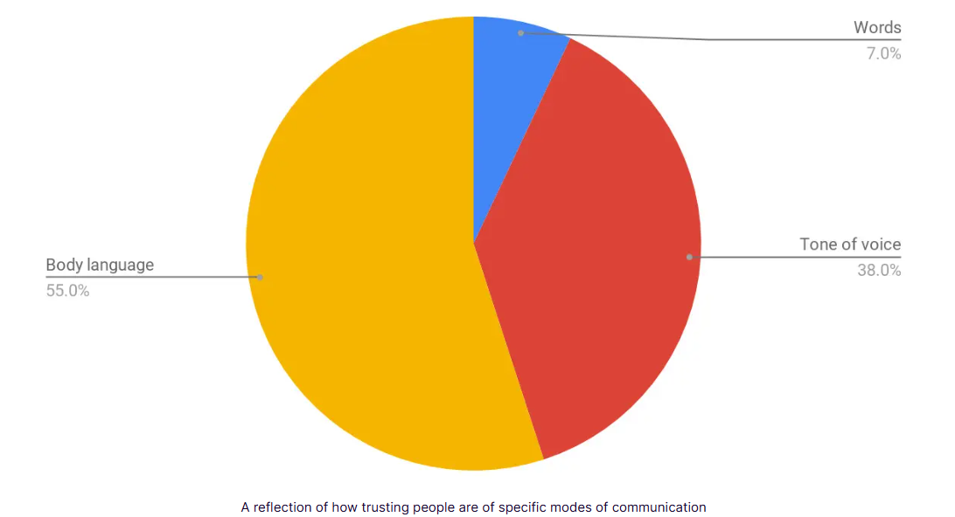
VERBAL VS. NON-VERBAL COMMUNICATION:
According to Mehrabian’s studies, nonverbal communication is more greatly weighted than verbal communication.
Notes:
Opening Context: “We communicate on many levels — not just through our words, but also through our tone and body language. In a customer-facing role, how we say something often matters more than what we say.” - It’s Not Just What You Say
📊 Explain the Model (show the pie chart while speaking):
“This concept was introduced by psychologist Albert Mehrabian. His studies found that in face-to-face communication, the message is interpreted as follows:
55% through body language – posture, gestures, eye contact
38% through tone of voice – pitch, pace, emotion, volume
Only 7% through the actual words we use”
👉 “So, when customers form impressions or emotional reactions, the majority of their perception comes from how we deliver our message — not just the words themselves.”
Make it Real (example to illustrate the point):
“For example: imagine a salesperson says, ‘You’re in good hands’ — but they’re slouched, avoid eye contact, and speak in a flat voice. Do you feel reassured? Probably not. This shows how misaligned tone and body language can undermine the message, even if the words are perfect.”
Important Clarification (briefly address any doubts):
“While some debate the exact percentages, what we do know is this: Non-verbal communication drives emotional responses. And emotions heavily influence trust, buy-in, and customer satisfaction.”
🧭 Transition to Next Slide:
“Now that we understand the weight of non-verbal communication, let’s explore the specific non-verbal techniques that help you reinforce — not sabotage — your message.”

Slide 54
MASTERING VERBAL COMMUNICATION
The Power of Tone
I didn’t say he stole the money.
How many different meanings can this sentence have, without changing anything?
I didn’t say he stole the money.
I didn’t say he stole the money.
I didn’t say he stole the money.
I didn’t say he stole the money.
I didn’t say he stole the money.
I didn’t say he stole the money.
I didn’t say he stole the money.
Notes:
Slide is animated each sentence appears one by one. (You display the exact sentence on screen with no explanation first): Write on FLIPCHART if you prefer!
Start with curiosity: Let me show you how tone alone can completely change meaning — even when the words never change.
Read the line 5 times — emphasizing a different word each time:
“I didn’t say he stole the money.” Implies someone else said it — not you. 🗨️ “Maybe a colleague said it, but not me.”
“I didn’t say he stole the money.” Implies denial — you’re contradicting a claim. 🗨️ “You’ve got it wrong — I never said that.”
“I didn’t say he stole the money.” Implies something was communicated differently — maybe implied or written. 🗨️ “I might’ve hinted it or thought it, but I didn’t say it.”
“I didn’t say he stole the money.”
➤ Suggests someone else stole it, not the person in question. 🗨️ “I meant someone else, not him.”
“I didn’t say he stole the money.”
➤ Suggests a different action — maybe borrowed or found. 🗨️ “He may have taken it, but it wasn’t stealing.”
I didn’t say he stole the money. ➤ Implied meaning: maybe he stole some money, or a different item. 🗨️ “I didn’t say he stole the money — just maybe something else.”
I didn’t say he stole the money. ➤ Implied meaning: he may have stolen something else, not money. 🗨️ “It wasn’t money, maybe it was data, documents, or time.”
“The words are identical, but the tone and emphasis shift the meaning entirely. This is a powerful reminder that tone communicates intent far more than the sentence itself.”
“So, when we speak to customers — especially in moments of tension or confusion — our tone can build trust, or destroy it, regardless of how ‘correct’ our words are.”
Now that we’ve seen how dramatically tone can shift the meaning of a sentence — let’s look at where this matters the most: when the customer can’t see us at all.
On the phone, your tone isn’t just part of the message — it is the message. That brings us to Telephone Etiquette.

Slide 55

MASTERING VERBAL COMMUNICATION
THE POWER OF TONE
Telephone Etiquette — Making Voice Count
Answer promptly and professionally
Smile while speaking — it reflects in your voice!
Speak clearly and at a moderate pace
Listen actively — no multitasking
Avoid interrupting; use verbal nods like “I understand,” “Yes,” etc.
Always confirm understanding before ending the call
Notes:
Let’s talk about something we often underestimate — the power of our voice on the phone.
When a customer calls in, they can’t see your facial expressions. They don’t know if you’re smiling, frowning, or even paying full attention. The only tool you have is your voice — your tone, pace, volume, and words.
So on the phone, tone becomes everything, It carries all the emotion, all the professionalism, and all the trust.
A warm, confident voice builds connection. A flat or rushed voice does the opposite — even if your words are polite.
Let’s look at a few principles that can help us make every phone interaction count
Now that we've seen how much tone can shape meaning, let’s look at the other powerful tool in our toolkit — body language — and how we can use it to reinforce our message instead of contradicting it.

Slide 56

MASTERING NON-VERBAL COMMUNICATION
Body Language
Eye contact, posture, gestures
Facial expressions and micro expressions
Personal space & cultural sensitivity
Non-verbal cues can support — or sabotage — your message
Notes:
Key Points to Cover:
Personal Space & Culture
In the Middle East, closer distance is often acceptable — but still observe cues
In other cultures, more distance = respect
Always gauge the customer’s comfort zone and mirror subtly
Non-Verbal Contradictions
Saying “I’d love to help you” while glancing at your watch = mixed message
Ensure tone, facial expressions, and body match your words

Slide 57

MASTERING NON-VERBAL COMMUNICATION
Your Body Speaks First
Posture = Confidence
Genuine Eye Contact Builds Trust
Respond To Their Energy, Not Just Their Words
Watch For Leaks: Your Face Tells The Truth

Slide 58
MASTERING NON-VERBAL COMMUNICATION
YOUR BODY SPEAKS FIRST
First Impressions are Physical
Walk in with Purpose
Grounded, Open Stance
Show You’re Present
Notes:
First impressions are non-verbal — your body speaks before your mouth does.
Walking in confidently (not rushing or slouching) signals professionalism.
A grounded stance (feet shoulder-width apart, no fidgeting) shows you’re stable and in control.
Enter like you belong in the room. That energy will influence the customer's mood.
Think of it like entering a performance — you're "on" the moment you're seen.
The moment you walk in, customers are assessing your presence.
Your walk, stance, and how you carry yourself signal confidence — or hesitation.
Sales begin before the first word.
Gestures & Movement
Purposeful hand gestures help reinforce speech
Avoid overuse or fidgeting — it distracts

Slide 59
MASTERING NON-VERBAL COMMUNICATION
POSTURE = CONFIDENCE
Posture That Sells
✅ Open, Upright = Trust
❌ Crossed Arms = Barrier
↔️ Slight Angle = Friendly
Notes:
Open posture signals honesty, confidence, and readiness to engage.
Slouching, leaning away, or turning your body sideways can signal disinterest or insecurity.
Arms crossed can be interpreted as defensive or disinterested — even if you’re just cold or thinking!
Angle your body slightly instead of facing customers dead-on — it's less confrontational and more welcoming.
Body language isn’t just what you do — it’s what the customer interprets.
Body Language Basics
Open posture = approachable, confident
Closed posture (arms crossed, turned away) = defensive or disengaged

Slide 60
MASTERING NON-VERBAL COMMUNICATION
EYE CONTACT = CONNECTION
Look Them in the Eye
3–5 Sec Rule
Focus Without Staring
Pair with Gestures
Notes:
Eye contact = confidence and connection (adjust by culture)
Eye contact builds rapport and attention, but it must feel natural, not forced.
3–5 seconds is usually enough before shifting to avoid making someone uncomfortable.
Don’t overdo it: too much can feel intense or even aggressive.
Use eye contact to emphasize key points — e.g., during a product reveal or pricing conversation.
Combine it with small nods or open hand gestures to enhance clarity and engagement.

Slide 61
MASTERING NON-VERBAL COMMUNICATION
RESPOND TO THEIR ENERGY, NOT JUST THEIR WORDS
Adapt to the Customer’s Energy, Posture & Tone
Friendly & Informal | Professional & Serious | Stressed
Use open posture, relaxed gestures, warm tone, and smiles. | Maintain good eye contact, use clear gestures, and a calm, respectful tone | Lower your voice, slow your pace, and reassure.
Notes:
“Now let’s look at how we communicate without saying a single word — through our posture, gestures, expressions, and tone.”
“This is where emotional intelligence plays a huge role. It’s not just what you say, it’s how you show up.”
Why Non-Verbal Matters
“Customers often respond more to how we make them feel than the exact words we use.”
“When there’s a mismatch between what we say and how we say it, customers sense it immediately.”
“That’s why we need to adjust our energy, tone, and body language to match the customer’s emotional state — not mimic, but align
Friendly & Informal“A relaxed customer may speak casually, use humor, or smile more. Match that energy with a friendly tone, smile, and relaxed posture.
Professional & Serious“Some customers are all business — they want quick, professional interactions. Keep your posture confident, your gestures minimal, and your language polished.
Stressed or Impatient“This is where it’s most critical. A stressed customer needs to feel safe and supported. Slow down, soften your voice, and show you’re truly listening. Avoid matching their frustration — be the calming presence.
Clarify “Responding to Energy”
“We’re not copying their movements or expressions. That would feel unnatural and even off-putting.”
“Instead, we’re adjusting our presence to complement theirs. It’s about emotional alignment — being responsive, not reactive.”
Why It Matters
“This builds trust and rapport, especially when emotions are high.”
“Non-verbal cues help the customer feel heard and understood — and that’s the foundation of a great customer experience.”
“So next time a customer walks in or reaches out — ask yourself: What energy are they bringing, and how can I meet them in a way that makes them feel supported?”

Slide 62
MASTERING NON-VERBAL COMMUNICATION
WATCH FOR LEAKS: YOUR FACE TELLS THE TRUTH
Your Face Tells the Truth
Mean Your Smile
Watch Micro-reactions
Face Shows What You Feel
Notes:
Facial expressions need to match the message you're delivering. If your voice is excited but your face is flat, customers pick up the contradiction.
Micro-expressions (quick flashes of emotion) can leak how you truly feel, even if you're trying to hide it.
Salespeople who fake interest or kindness will eventually be exposed by their facial cues.
Practice “smiling with your eyes” — not just your mouth — when greeting or presenting.
When talking about a feature the customer loves, mirror their enthusiasm with open expressions.
Facial Expressions
Smile = openness and friendliness
Raised brows, frown, tight jaw = tension or confusion
Train consultants to check their face before approaching

Slide 63

MASTERING NON-VERBAL COMMUNICATION
Body Language = Sales Language
What you say is filtered through what they see.
Align your intent, words, and body to build trust and influence.
Your presence is your first selling tool — own it.
Notes:
Align your intent, words -Non-Verbal Contradictions
Saying “I’d love to help you” while glancing at your watch = mixed message
Ensure tone, facial expressions, and body match your words

Slide 64

COMMUNICATION - LISTENING
What tells you someone is not listening / bad listener?
So what I really need is something reliable for my daily commute...
What should I say next?
Speaker
Listener
Why Listening Fails!
The biggest communication problem is we do not listen to understand. We listen to reply.
— Stephen R. Covey
Notes:
Today’s session is about fixing that. Listening isn’t waiting your turn—it’s understanding what matters to the other person.
Have you ever had a conversation where you could tell the other person wasn’t really with you—just waiting for their turn to speak? That’s exactly what this image shows.
One person is talking. The other is not listening to understand—they’re already crafting their response. You can see it in the thought bubble: ‘What should I say next?’
And here’s the thing—customers feel this. They may not say it, but they know when you're present… and when you're not.
This brings us to one of the biggest truths about communication—Stephen Covey said it best: 'We don’t listen to understand. We listen to reply.'
Today, we’re going to change that. We’ll explore how to move from passive or selective listening to empathetic listening, where customers feel genuinely heard—and where trust is built."

Slide 65
ACTIVITY 4: Listening skills
Participants will listen as the instructor reads a short passage. Afterwards, the instructor will ask questions to assess how well the information was received and understood.
Individual
5 minutes

Slide 66
COMMUNICATION - LISTENING
The Listening Ladder: From Passive to Empathetic
Listening with emotion and intent
Full attention on content
Passive
Selective
Active
Empathetic
Filtering only what interests you
Hearing but not engaged
Notes:
Ask: “Where do you think customers feel the difference most?”
Interesting read touch on. What’s the difference between listening and hearing?
Hearing and listening have quite different meanings. Hearing is a passive occurrence that requires no effort. Listening, on the other hand, is a conscious choice that demands your attention and concentration. When you hear what people are saying, the sounds have no significance until you place meaning to the words.
Active listening takes things on from simply listening. This is a structured communication technique that means you must make a conscious effort to understand what people are saying as well as the meaning behind their words. It helps build empathy and trust between the people communicating and ensures the correct message is being understood.
If you want to become a better listener, you should learn the techniques of active listening.
Active listening is not just sitting in silence while someone else talks. The skills of active listening can be summed up in a mnemonic…

Slide 67
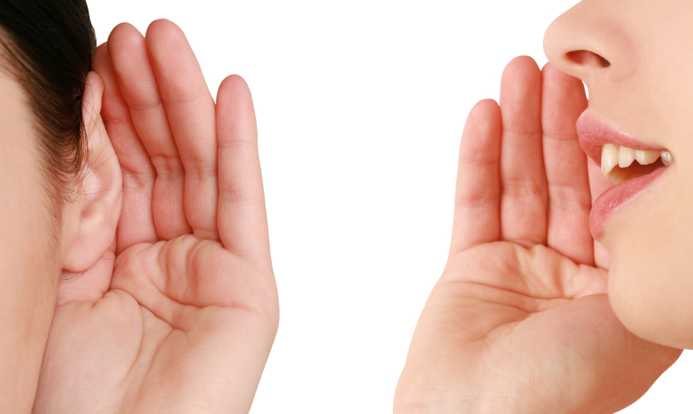
ACTIVE LISTENING TECHNIQUES
Listening to Understand, Not Just Respond
Paraphrasing & Summarizing
Asking Clarifying Questions
Empathy & Patience in Action

Slide 68

ACTIVE LISTENING TECHNIQUES
Reflective Techniques That Build Trust
Paraphrasing & Summarizing
Paraphrasing: Restating the message in your own words to show understanding.
Summarizing: Condensing key points after a longer conversation.
Asking Clarifying Questions
Empathy & Patience in Action
Notes:
Example: Customer: “I want something safe, with good fuel efficiency and a modern design.” Consultant: Paraphrase: “So safety and efficiency matter most, with a modern look?”
Summarize (later): “You’re leaning toward a car that’s stylish, economical, and gives peace of mind for your family.”
Paraphrasing – “So you’re saying reliability is your top priority, right?”
Summarizing – “Just to recap, you’re looking for a family SUV with safety, space, and low maintenance.”
Ask what are the benefits of doing this?
✅ Shows the customer you’re listening ✅ Clarifies assumptions ✅ Reduces misunderstandings

Slide 69

ACTIVE LISTENING TECHNIQUES
Asking Clarifying Questions – Avoid Guesswork
Paraphrasing & Summarizing
Why It Matters:
Clarifies vague statements
Prevents assumptions
Deepens connection
Asking Clarifying Questions
Empathy & Patience in Action
Notes:
Examples: “When you say ‘comfortable,’ do you mean the ride quality or the seat design?” “What do you mean by ‘value for money’—low price or long-term savings?”
Examples:
“When you say ‘better tech features,’ can you share what matters most to you—navigation, connectivity, or safety alerts?”
“What do you mean by 'easy to drive'—do you mean visibility, comfort, or maneuverability?”
Trainer Insight
✳️ Clarifying questions show curiosity, not doubt. They reduce assumptions and uncover the deeper need behind the surface request.
Use neutral language and a calm tone. The goal is understanding, not interrogation.

Slide 70

ACTIVE LISTENING TECHNIQUES
It’s Not Just the Product—It’s How You Make Them Feel
Paraphrasing & Summarizing
Empathy:
Listen with full attention
Reflect emotions: “Sounds like this has been a tough experience for you.”
Patience:
Avoid interrupting
Leave space for silence
Let them express at their pace
Asking Clarifying Questions
Empathy & Patience in Action
Notes:
Insight Quote:
“Empathy builds trust. Patience keeps it.”
Acknowledge emotions: “I understand this decision is important for your family’s safety.”
Show you care: “It sounds like this has been a frustrating process—thank you for sharing that with me.”
Empathy makes customers feel heard. Patience makes them feel respected.

Slide 71
ACTIVITY 5: Active Listening - Exercise
Take turns to speak on a topic of your choice for two minutes. The person listening should use active listening techniques to demonstrate their interest and understanding.
Pairs
Suggested topics…
What you did on your most favourite holiday
Your favourite sport and why you like it
Your pet and why you like it
What you would do if you won the lottery
10 minutes
Notes:
Place participants into pairs and explain that you would like them to practice the skills of active listening. Participants should take it in turns to speak on a topic of their choice for two minutes. The person listening should use active listening techniques to demonstrate their interest and understanding.
When the speaker has finished talking, the ‘active listener’ should reflect back what the other person said and felt.
In review, discuss the participant’s findings. How easy was it to actively listen? What did they discover about the process? What went well? What could they improve?

Slide 72
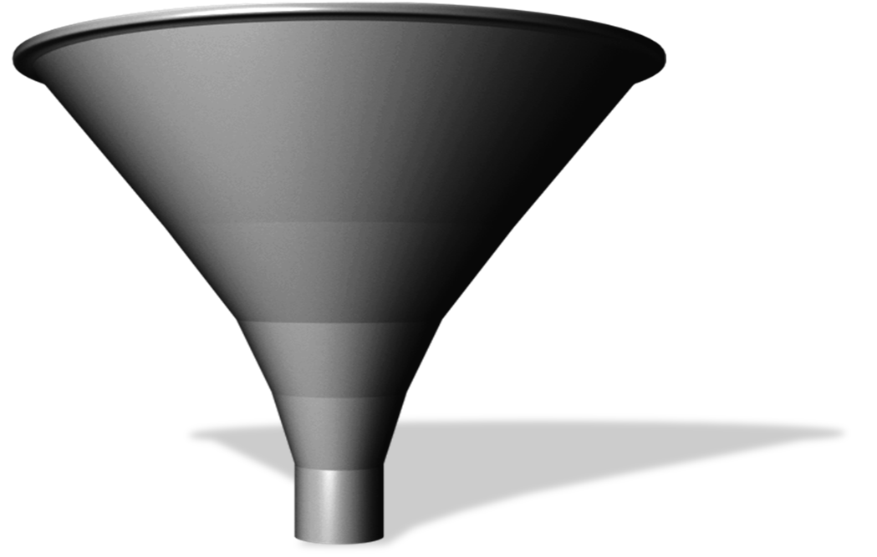
EFFECTIVE QUESTIONING TECHNIQUES
Asking the Right Questions using Funnel Technique
Open
Probe
Clarify
Probe
Closed
C
H
E
C
K
Understand
Notes:
Open → Probe → Closed → Check works as a natural question funnel in sales.
The first three (Open, Probe, Closed) clarify the customer's needs progressively.
The final Check confirms understanding and sets the foundation for the next step.
1. Open Questions – Start the Conversation
Purpose: Explore customer’s big picture wants or situation.
Talking Point: “Open questions invite stories, not yes/no answers.”
Example: “What are you looking for in your next vehicle?”
2. Probing Questions – Dig Deeper
Purpose: Explore emotions, motivations, or underlying reasons.
Talking Point: “These help uncover what truly matters — comfort, safety, tech, status, or reliability.”
Example: “You mentioned safety — tell me more about what makes you feel safe in a car.”
3. Closed Questions – Confirm Details
Purpose: Get specific info or decisions.
Talking Point: “Useful to clarify facts or preferences.”
Example: “So, you’d prefer an SUV over a sedan, right?”
4. Check for Understanding – Validate & Align
Purpose: Summarize and check alignment before presenting a solution.
Talking Point: “This builds trust and ensures your recommendation hits the mark.”
Example: “Just to confirm: You’re looking for a fuel-efficient SUV, ideally with advanced safety features and enough space for your two kids?”

Slide 73
ACTIVITY 6: Qualification Questions
In your group on the flipchart write as many questions as you can to qualify and understand the customer
Group Exercise
5 minutes
Notes:
Once the activity is done ASK What types of questions did we use?
This is trigger conversations for the next slide and also gauge the group's current level of questioning skill.
Once they list their questions, you can reveal blind spots: Are they asking too many closed questions? Too many “why” questions?
This creates a natural transition to the 3-tier model, which now feels relevant and needed.

Slide 74
EFFECTIVE QUESTIONING TECHNIQUES
Open Questions
🔵 Top Tier:
Build Trust and Insight
How – Process, feeling, experience What – Preferences, motivations, expectations
HOW WHAT
Who – Stakeholders When – Timing Where – Usage context
🟡 Middle Tier:
Clarify Facts
WHO
WHEN
WHERE
🔴 Caution Tier:
Can Trigger Defensiveness
WHY
Why – Use sparingly
Notes:
Group the questions based on emotional impact and usefulness in a sales conversation.
🔵 Trust-Builders: “How” and “What” encourage open dialogue – they're non-threatening and invite storytelling.
🗣️ “What matters most to you in a new car?” 🗣️ “How will you mostly use the vehicle?”
🟡 Neutral Clarifiers: “Who,” “When,” and “Where” add detail – but only after building rapport.
🗣️ “Who else will be using the vehicle?” 🗣️ “When do you plan to make your decision?” 🗣️ “Where will you be driving most often?”
These are neutral but can sometimes feel scripted or abrupt if not softened.
🔴Potential Triggers “Why” can shut down trust if used too soon – reframe with “What led you to...” or “How did you decide...?”
Feels like a challenge or judgment
Use only when trust is already built or with gentle tone
🚫 “Why do you think that?” ✅ “What led you to that choice?”
Adapt based on customer mood – especially with “Why.”

Slide 75
EFFECTIVE QUESTIONING TECHNIQUES
Reframing “Why” Questions
Avoid putting customers on the defensive. Reword “Why” into “How” or “What” for more trust and insight.
Examples:
❌ Why didn’t you go for the higher trim?
✅ What made you choose this specific grade?
❌ Why do you want to change your current car?
✅ What are you looking for that your current car doesn’t provide?
❌ Why is that important to you?
✅ How does that feature support your daily driving needs?
Notes:
Introduce the Concept: “In sales, why questions can feel interrogative, even if our intent is positive. Customers may feel they need to defend their choices.”
Walk Through Examples: Examples are animated to show the why question first. Ask them to reframe “Why” questions into “What” or “How.” (Let them try to think of a better way of reframing)
Facilitate Discussion: ‘How does the rephrased question change the tone of the conversation?’
“Which of these reframed versions would you be more comfortable saying? Why?” “Which ones help the customer open up more?”
Optional Activity: Ask learners to take a few “why” questions they used earlier and rewrite them as “how” or “what” questions. Share with the group.
Wrap with Key Message: “The goal isn’t to avoid curiosity — it’s to phrase curiosity in a way that builds trust.”

Slide 76
EFFECTIVE QUESTIONING TECHNIQUES
Techniques to Uncover What’s Not Said
Listen for hesitation, vague answers, or contradictions
Ask follow-up questions like “Can you tell me more?”
Use reflective listening: “It sounds like you’re unsure about…”
Watch non-verbal cues for discomfort or interest
Summarize and check: “So what matters most is…”
Notes:
Wrap up on the questioning techniques, to avoid objections.
- Customers don’t always say what they’re truly thinking — either because they’re unsure or hesitant.
- As consultants, our job is to gently surface what’s really holding them back or what they haven’t yet articulated.
- Walk through the five points, linking to earlier topics like tone matching, body language
Ask: “Have you ever had a customer say ‘I’ll think about it’ — but you sensed there was more going on?”
Reinforcement Message: Ultimately, everything we’ve practiced today helps you speak like someone your customer trusts.
Convert it into a Reflective Wrap-Up by asking the question on slide : What specific things do you say or do that help your customer feel they’re in good hands?

Slide 77
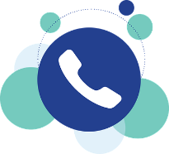


DIGITAL COMMUNICATION
Present-day communication
You and your customers can easily share conversations, pictures, images, graphics, maps and thousands of things thanks for the development of electronic communication.
They are streamlined for the busy world of work.
They give information quickly.
Notes:
Worldwide communication has been simplified by the electronic transmission of data which connects individuals, regardless of geographic location, almost instantly.
You and your customers can easily share conversations, pictures, images, graphics, maps and thousands of things thanks for the development of electronic communication.
Electronic communication is today’s most preferred medium of communication, because:
However, there are clear advantages and disadvantages of electronic communication that apply on both the sender and receiver (Advisor/Customer) and need to be considered when communicating electronically.
[Click to go to the next slide – Advantages and disadvantages]

Slide 78
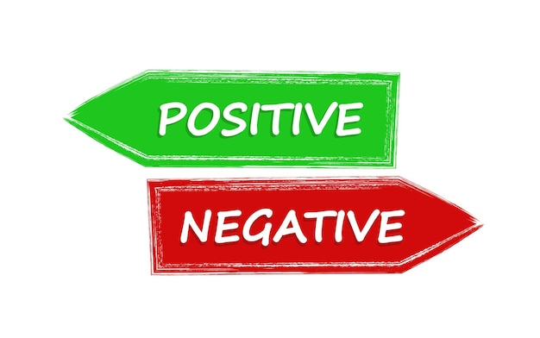
DIGITAL COMMUNICATION
What are the advantages & disadvantage of digital communication?
Speedy transmission
Wide coverage
Flexibility
Low cost
Exchange of feedback
ADVANTAGE
No body language
Information overload
Time lag
Undelivered data
Dependency
DISADVANTAGE
Notes:
When Words Are All You Have
In writing, especially in chat or email, we lose tone and body language — which means our words carry the full weight of the message.
Customers can’t see your smile — they feel your intent through how clearly, politely, and professionally you write.
Advantages:
Speedy transmission - It requires only a few seconds to communicate through electronic media because it supports quick transmission.
Wide coverage - The world has become a global village and communication around the globe requires a second only.
Flexibility - Accessible 24×7, any place as long as you have an internet connection.
Low cost - Electronic communication saves time and money. For example, E-mail is significantly cheaper than customer travelling
Exchange of feedback - Electronic communication allows the instant exchange of feedback. So communication becomes perfect using electronic media.
Disadvantages:
No body language - Just like other written communication methods; without facial expressions and gestures or the ability to retract immediately there’s a big risk of misunderstanding.
Information overload - A large volume of messages can be overwhelming and hard to follow, even stress-inducing.
Time lag - even if you log on daily, 24 hours can seem like a long time if you’re waiting for a reply; and then the discussion could have moved on and left you behind.
Undelivered data - Data may not be retrieved due to system error or fault with the technology. Hence required service will be delayed.
Dependency –

Slide 79
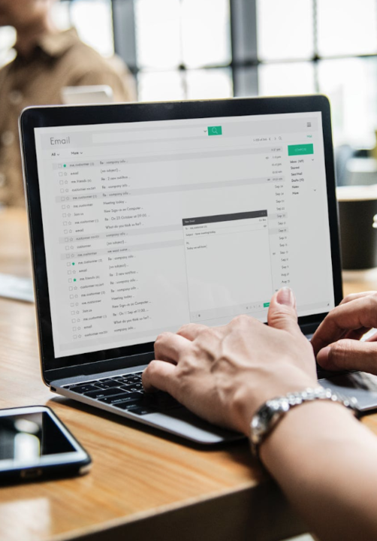
DIGITAL COMMUNICATION
Email Etiquette
Used when:
Customer messages via email
Communication is more formal, includes offers, follow-ups, test drive confirmation, etc.
Be clear & concise
Answer all questions
Double-check for grammar/spelling
Personalize your response (not robotic)
Use templates
Answer promptly within 2 hours max
No unnecessary attachments
Avoid jargon or abbreviations (unless agreed)
Notes:
DO:
Review and discuss the technique of email and text greetings
ASK:
How many of you use email or text for customer communications?
Take answers, look for ideas like:
Becoming more popular with many customers
Once customers know they can text you, they tend to use it over phone calls
SAY:
For email and text communications, you can also follow a basic set of guidelines
Be concise and to the point. Do not make any text or email longer than it needs to be
Answer all questions. Ask follow-up questions if you need more information from the customer to answer him or her correctly
Use proper spelling, grammar, and punctuation. Use the spell checker available on most modern text and email systems
Make it personal. Make sure that you add a personal touch so that the customer does not think the email is one that is sent to every customer
Use templates for frequently used responses. Some questions you get over and over again, such as directions to your dealership. Save these texts as response templates and paste them into your message when needed
Do not attach unnecessary files unless it has been specifically asked for by the customer. Doing this can annoy customers and even bring down their email system due to file-size restrictions

Slide 80
DIGITAL COMMUNICATION
📧 Email Structure (Formal / Semi-Formal)
Subject Line – Clear and specific
Greeting – Use customer's name
Opening Line – Acknowledge the inquiry or thank them
Body – Provide clear, structured information. Use bullet points if needed.
Closing Line – Reassure, invite questions, and offer help
Sign-off – Use a polite closing
Notes:
Example:
Subject: Your Honda CR-V Test Drive Confirmation
Email Body:
Dear Mr. Ahmed,
Thank you for your interest in the new Honda CR-V.
I'm pleased to confirm your test drive appointment as follows:
Date: Monday, 10th June
Time: 4:00 PM
Location: Honda Showroom – Sheikh Zayed Road
Contact: Ask for me at the reception upon arrival
You’ll be driving the CR-V EX grade, so you’ll experience key features such as Honda Sensing, panoramic sunroof, and the spacious interior firsthand.
If you'd like to explore a different grade or reschedule the time, feel free to reply to this email or reach me directly on WhatsApp.
Looking forward to meeting you.
Best regards, Ali Khan Sales Consultant – Honda 📞 +971 50 123 4567 📧 ali.khan@tradingenterprises.ae

Slide 81
ACTIVITY 7: Email Etiquette
Provide a professional and informative reply to the following customer email.
Individual
5 minutes
Notes:
Show the next slide with the email from the customer

Slide 82
DIGITAL COMMUNICATION
📧 Customer Email
Subject: Feedback on Recent Car Hire Experience
Dear Hertz Customer Service,
I’m writing to express my disappointment with a recent car rental experience.
Firstly, the pickup process was extremely slow, taking far longer than expected despite having a confirmed booking. Once I finally received the vehicle, I encountered a serious issue: the car began overheating shortly after departure, which made the drive both stressful and unsafe.
To make matters worse, the time it took to get a replacement vehicle was unacceptably long, further disrupting my schedule.
Given the inconvenience caused, I feel very strongly that I should be offered appropriate compensation for the experience.
Sincerely, [Customer Name]
Notes:
Example:
Subject: Your Honda CR-V Test Drive Confirmation
Email Body:
Dear Mr. Ahmed,
Thank you for your interest in the new Honda CR-V.
I'm pleased to confirm your test drive appointment as follows:
Date: Monday, 10th June
Time: 4:00 PM
Location: Honda Showroom – Sheikh Zayed Road
Contact: Ask for me at the reception upon arrival
You’ll be driving the CR-V EX grade, so you’ll experience key features such as Honda Sensing, panoramic sunroof, and the spacious interior firsthand.
If you'd like to explore a different grade or reschedule the time, feel free to reply to this email or reach me directly on WhatsApp.
Looking forward to meeting you.
Best regards, Ali Khan Sales Consultant – Honda 📞 +971 50 123 4567 📧 ali.khan@tradingenterprises.ae

Slide 83
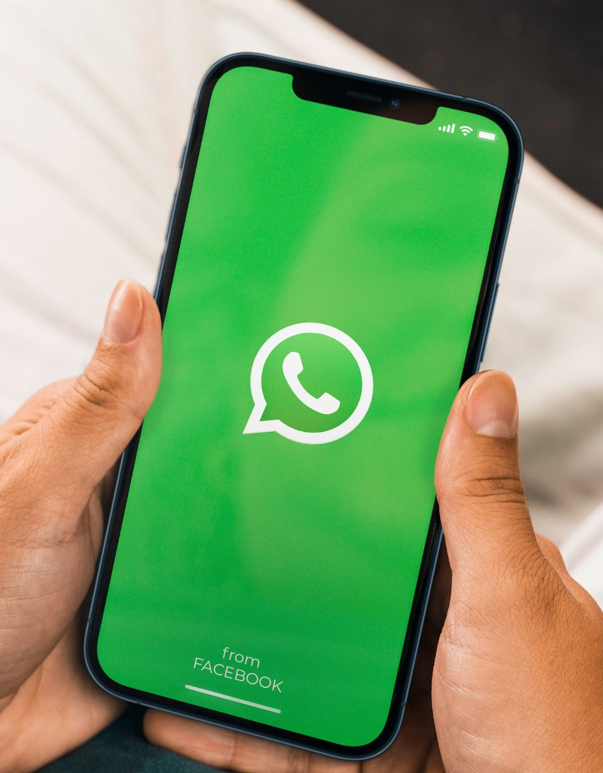
DIGITAL COMMUNICATION
WhatsApp Message
Used when:
Customer reached out through WhatsApp
Conversation tone is more casual but still professional
You're following up, confirming appointments, or sharing quick info
WhatsApp can be formal or informal
Clarity is more important than length.
Never skip the customer’s name, even in casual WhatsApp.
Emojis on WhatsApp: Use selectively
Always check tone and read before sending
Notes:
WhatsApp can be formal or informal — depending on the customer relationship.
Emojis on WhatsApp: Use selectively — warm, never silly (e.g., ✅ 😊 not 😂🔥).Be clear & concise
Always check tone and read before sending — customers may misinterpret short or blunt replies.

Slide 84
DIGITAL COMMUNICATION
WhatsApp Message Structure (Semi-Formal / Friendly)
Greet by name + Introduce yourself
State the purpose clearly upfront
Key Info (keep it short, 1–2 lines max)
Use emojis sparingly to keep tone warm, not casual
Offer a way to reach out or ask questions
Sign off with your name and brand
Notes:
Hi Mr. Ahmed, 👋 This is Ali from Honda – just confirming your CR-V test drive on Monday at 4 PM at our Sheikh Zayed Road showroom.
You’ll be trying the EX grade with all the top features like panoramic sunroof and Honda Sensing. 🚗✨ Let me know if you'd like to reschedule or explore another variant.
Looking forward to seeing you! Ali – Honda 🚘 📞 050 123 4567
Follow up example:
Hi Ms. Fatma, 👋 Thank you again for visiting us yesterday to explore the Honda ZR-V EX.
As discussed, the final price including VAT, registration, and tinting is AED 119,900. This offer is valid until Saturday, and we also have 0% down payment options available if you’re financing.
Let me know if you’d like me to reserve the vehicle or share the EMI details. Happy to support anytime. 😊
Ali – Honda 📞 050 123 4567

Slide 85
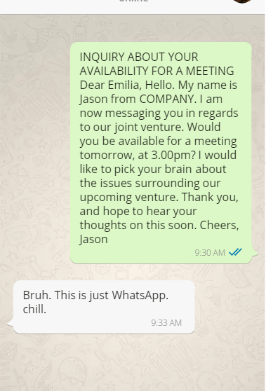
DIGITAL COMMUNICATION
WhatsApp Guidelines
Always ask permission before starting to use Whatsapp with customers.
Never send a text to a customer after working hours unless he started to text first. You can always reply.
Be very aware of sending Whatsapp messages to ladies. It is treated personal.
Do not treat a Whatsapp message like an email, yet you need to be professional and polite.

Slide 86
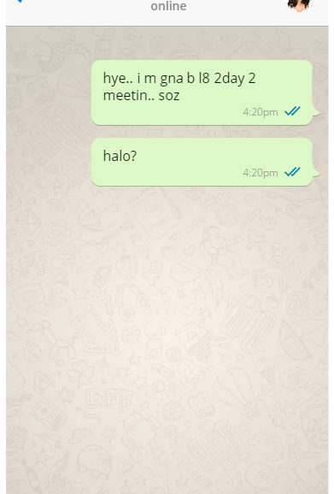
DIGITAL COMMUNICATION
WhatsApp Guidelines
Never use unrecognizable short forms. It is very unprofessional.
Do not use emoji. It can be misunderstood (If used - use selectively )

Slide 87
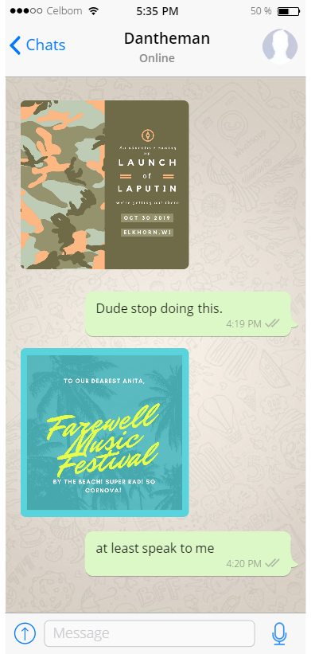
DIGITAL COMMUNICATION
WhatsApp Guidelines
Do not send pictures or files to customers without prior notification. It is considered spam.

Slide 88
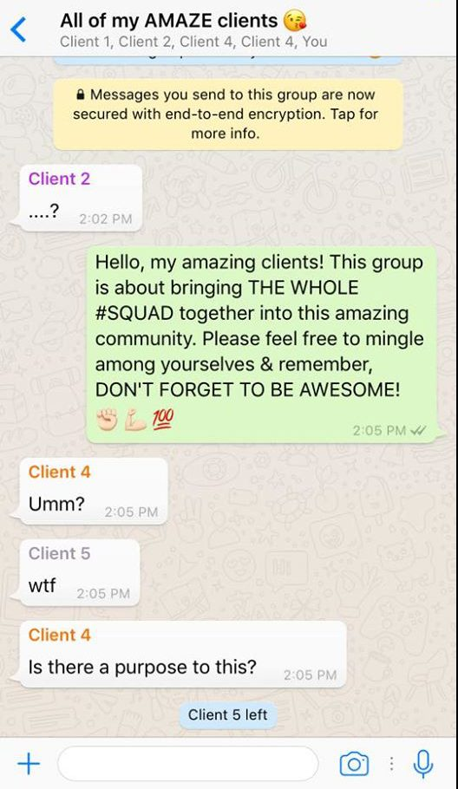
DIGITAL COMMUNICATION
WhatsApp Guidelines
Never add your customers into groups with strangers without prior permission.

Slide 89
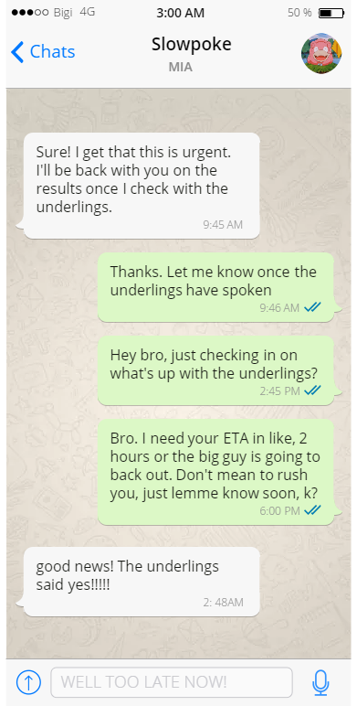
DIGITAL COMMUNICATION
WhatsApp Guidelines
Respond as soon as possible. Always give a promise date to manage the expectations of the customer.
Always meet your promise dates/time.
Notes:
taking too long.

Slide 90
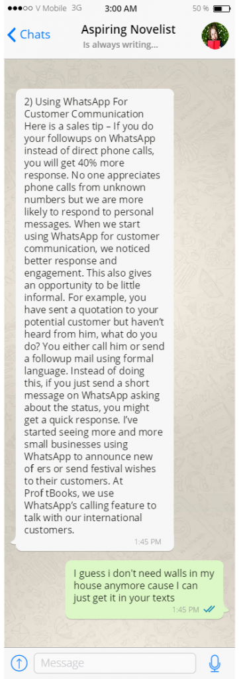
DIGITAL COMMUNICATION
WhatsApp Guidelines
Avoid very long messages. It is perceived as impersonalized way of communication and also as spam.
Instead, use Whatsapp to ask if they are free for a call.
Notes:
Reading long walls of texts is always annoying, but it is almost triply so on WhatsApp. Especially so when you’re scrolling down the long string of words. At least on WhatsApp, your clients are thinking “Nobody has time to read all of this,” which is now wasted effort on your part because you had to type all of that out.
If you really have that much to say, you can probably say it better in a call or on email. Heck, use WhatsApp to ask if they’re free for a call. It’s certainly less things to type.

Slide 91
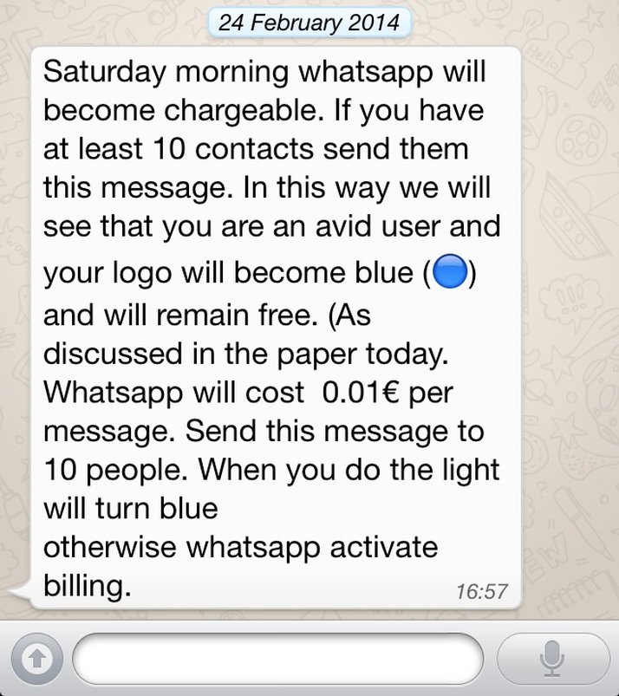
DIGITAL COMMUNICATION
WhatsApp Guidelines
Never use long chainmail “copypastas”.

Slide 92
ACTIVITY 8: Email Etiquette
Reply to the following whatsapp message from a customer.
Individual
5 minutes
Notes:
Show the next slide with the WhatsApp message

Slide 93
DIGITAL COMMUNICATION
Customer WhatsApp Message
Hi there 👋
I’m looking to rent a car and wanted to check availability and pricing. Could you please let me know what options you have, including any current offers or packages? I’d also appreciate details on pickup and drop-off locations in Dubai.
TIA

Slide 94
3
SECTION
CUSTOMER PROFILING

Slide 95

CUSTOMER PROFILING
Customer Types
Knowing how to deal with different types of customers is key to being successful.
Notes:
Effective communication skills are the key to successful conversations. It's all about expressing yourself clearly and listening carefully to others. Imagine it as a two-way street – you share your thoughts, and you also pay attention to what others are saying.

Slide 96

CUSTOMER PROFILING
WHAT IS DiSC?
The DiSC profile, is a non-judgmental tool used for discussion of people's behavioral differences.
Notes:
Module 2: Make a Connection
Why DiSC?
Ask:
Who is familiar with DiSC? (Show of hands)
Who has taken the assessment? (Show of hands)
Note: Some participants may have previously completed the DiSC assessment. Make the point that some people change over the years, so it’s instructive to take the assessment again.
Key Points:
DiSC measures observable, instinctive behaviors, or “styles”
Completing DiSC is the first step toward a better understanding of you and your customers
We’ll explore how this information can improve your ability to adapt to your customers
With practice, you can use this skill to form stronger connections with your customers
Go To The Next Slide

Slide 97
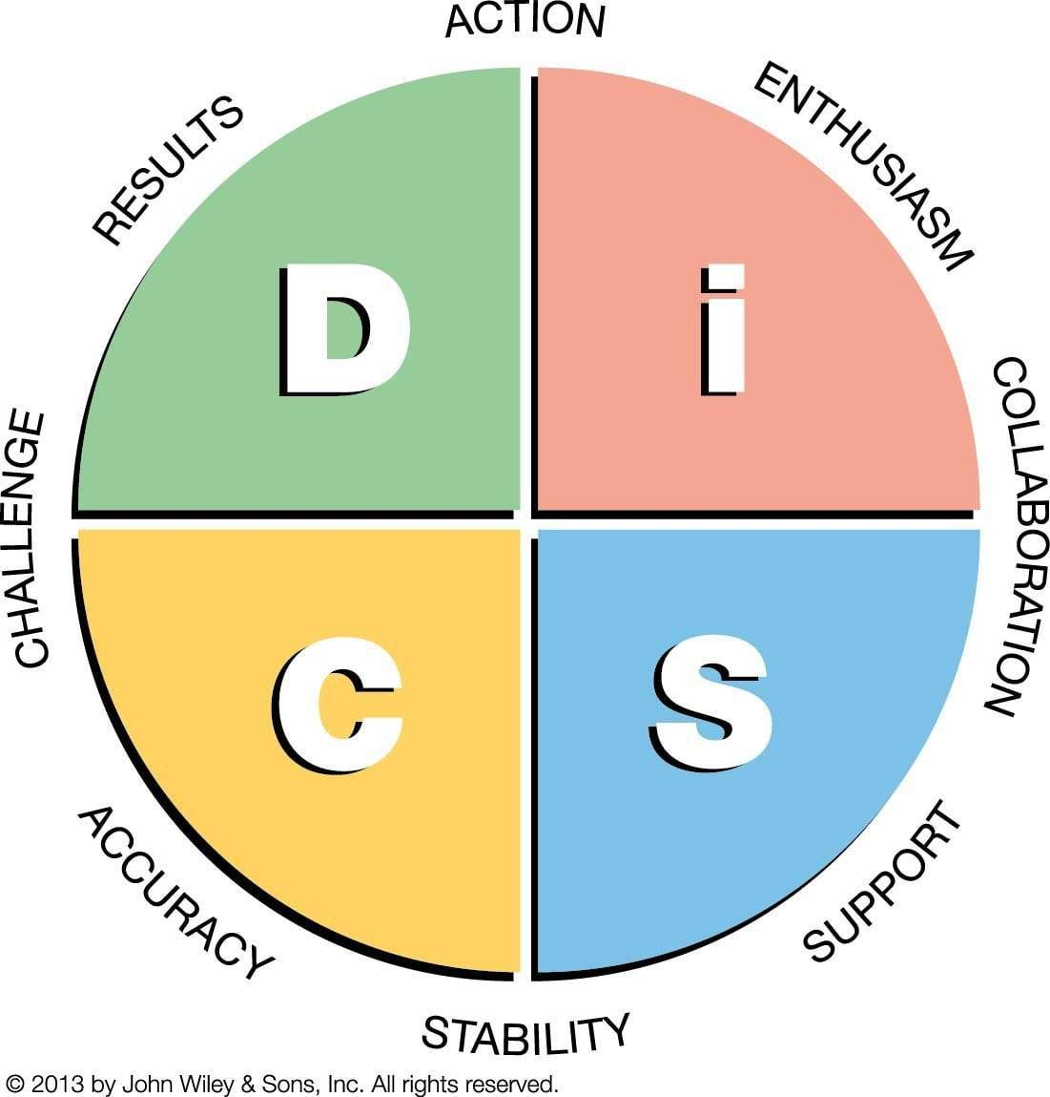
CUSTOMER PROFILING
Why DiSC?
By learning to read your customers’ behavioral styles — and by knowing your own — you can adapt your style to form a stronger connection

Slide 98
CUSTOMER TYPES
How do we identify the different types of customer?
Let’s take each one in turn and consider how we communicate best with them
DOMINANCE
INFLUENCE
CONSCIENTIOUS
STEADINESS

Slide 99
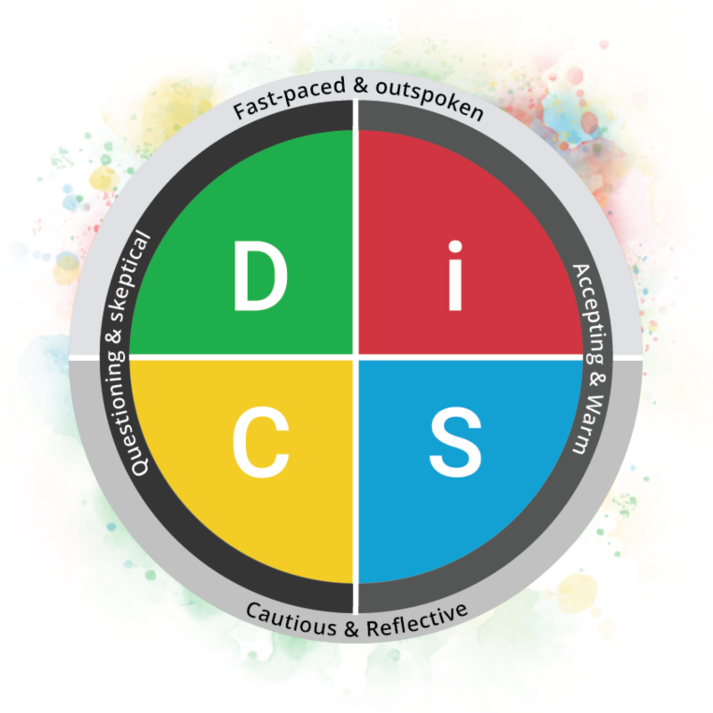

Slide 100
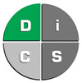


DOMINANCE
CHARACTERISTICS:
Driven
Direct
Decisive
Strong-willed
Self-confident
Daring
Determined
Fast-paced

Slide 101
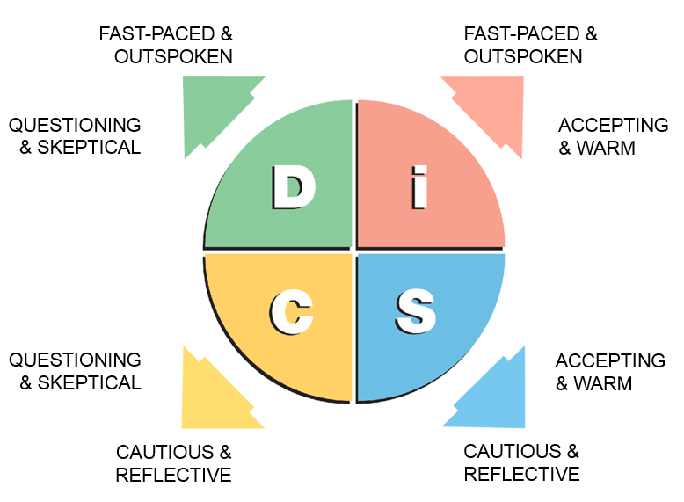
DOMINANCE
CHARACTERISTICS:

Slide 102
DOMINANCE
MOTIVATORS:
Motivated by winning, competition and success.
Values competency, concrete results, personal freedom

Slide 103

DOMINANCE
“Don’t waste my time!”
How do we communicate best with these customers?
COMMUNICATING WITH “D” STYLES:
Be direct and to the point.
Focus on results and key outcomes.
Present the bottom line early—don’t over-explain.
Show confidence and efficiency.
Avoid being overly emotional or hesitant.
Notes:
Be direct and to the point. → “They appreciate clarity and brevity. Avoid small talk and get to the main message quickly.”
Focus on results and key outcomes. → “They’re goal-driven. Talk about what will be achieved, not the process.”
Present the bottom line early—don’t over-explain. → “Start with your conclusion or proposal, then back it up if needed.”
Show confidence and efficiency. → “They respond well to assertiveness and want to know you can keep up.”
Avoid being overly emotional or hesitant. → “Keep it factual and confident—too much emotion may be seen as weakness.”
HOW TO WORK WITH?
Support their goals and objectives
Keep the relationship business-like
If you disagree, focus on the facts
Be prepared, time-disciplined and well organized
Get right to the point
Focus on their goals and agenda
Show clear solutions, rewards and “bottom-line” results
Don’t compliment them excessively
To motivate, give them enough information and alternatives in order to decide (and they will)

Slide 104
DOMINANCE
PRIORITIES:

Slide 105
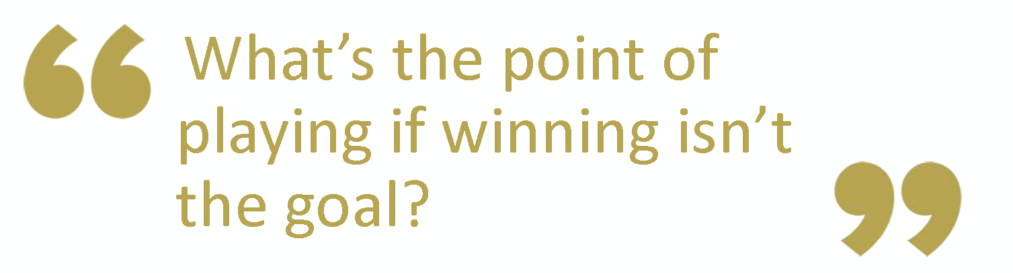
DOMINANCE
D-STYLE QUOTE:

Slide 107
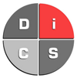

INFLUENCE
CHARACTERISTICS:
Charming
Collaborative
Energizing
Trusting
Enthusiastic
Impulsive
Optimistic
Persuasive

Slide 108
INFLUENCE
CHARACTERISTICS:

Slide 109
INFLUENCE
MOTIVATORS:
Motivated by social recognition, group activities, and relationships
Values coaching and counseling, freedom of expression and individuality

Slide 110

INFLUENCE
“I LOVE red … don’t you?”
How do we communicate best with these customers?
COMMUNICATING WITH “I” STYLES:
Be enthusiastic and friendly.
Engage in small talk before getting to business.
Use expressive language and gestures.
Allow them to talk and share their ideas.
Avoid being too rigid, formal, or data-heavy.
Notes:
Be enthusiastic and friendly. → “Start with positive energy—they value personal connection.”
Engage in small talk before getting to business. → “A quick chat about their day or interests builds rapport.”
Use expressive language and gestures. → “They’re animated and expressive—mirror that energy to keep them engaged.”
Allow them to talk and share their ideas. → “They enjoy brainstorming and being heard. Don’t cut them off too soon.”
Avoid being too rigid, formal, or data-heavy. → “Keep it light, conversational, and idea-focused rather than detail-focused.”
HOW TO WORK WITH?
Support their opinions, ideas and beliefs
Do not hurry discussions; let them ramble
Never argue with them!
Always summarize (in writing, or they will forget)
Be outgoing and fast-moving; they HATE boring people
Allow them to do most of the talking
Compliment their ideas
Learn their dreams and vision
To motivate, give special deals

Slide 111
INFLUENCE
PRIORITIES:

Slide 112
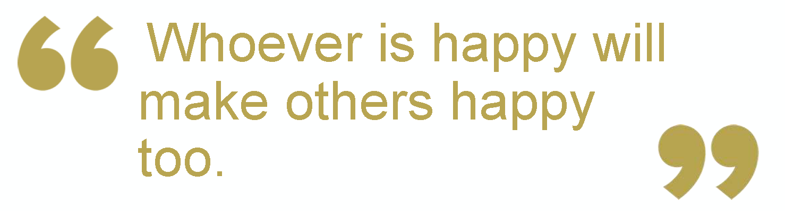
INFLUENCE
I-STYLE QUOTE:

Slide 114
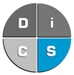

STEADINESS
CHARACTERISTICS:
Calm
Patient
Predictable
Deliberate
Stable
Warm
Passive
Loyal

Slide 115
STEADINESS
CHARACTERISTICS:

Slide 116
STEADINESS
MOTIVATORS:
Motivated by cooperation, opportunities to help and sincere appreciation
Values loyalty, helping others, and security
Notes:
Michelle Obama

Slide 117

STEADINESS
“Can I trust you?”
How do we communicate best with these customers?
COMMUNICATING WITH “S” STYLES:
Be personal and amiable.
Express genuine interest in them.
Take time to provide clarification.
Be polite.
Avoid being confrontational or too aggressive.
Notes:
Be personal and amiable. → “Start with a warm tone—they value trust and connection.”
Express genuine interest in them and clearly explain what you expect. → “They’re supportive team players—be clear but caring in your communication.”
Take time to provide clarification—offer step-by-step guidance. → “They don’t like surprises. A calm, steady approach reassures them.”
Be polite and patient. → “They may take longer to decide—don’t rush or pressure them.”
Avoid being confrontational or too aggressive. → “They avoid conflict—approach sensitive topics gently and respectfully.”
HOW TO WORK WITH S
Support their feelings; show personal interest
When you disagree, discuss personal feelings
Move the business process in a slow, informal manner; proceed at a good, steady pace
Listen actively and show concern
Provide proof of minimal risk (personal guarantee)
Build a strong relationship and trust
Close without pushing

Slide 118
STEADINESS
PRIORITIES:
Notes:
HOW TO WORK WITH?
Support their feelings; show personal interest
When you disagree, discuss personal feelings
Move the business process in a slow, informal manner; proceed at a good, steady pace
Listen actively and show concern
Provide proof of minimal risk (personal guarantee)
Build a strong relationship and trust
Close without pushing

Slide 119
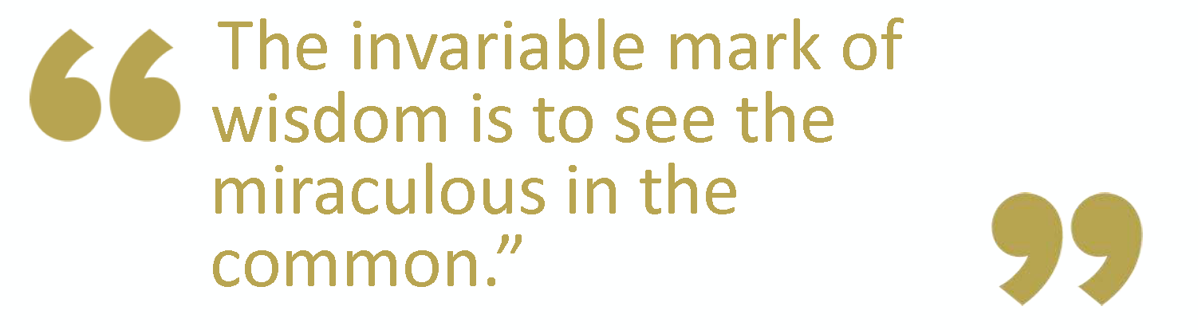
STEADINESS
S-STYLE QUOTE:

Slide 121
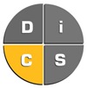

CONSCIENTIOUS
CHARACTERISTICS:
Cautious
Systematic
Private
Objective
Analytical
Diplomatic
Accurate
Reserved

Slide 122
CONSCIENTIOUS
CHARACTERISTICS:

Slide 123
CONSCIENTIOUS
MOTIVATORS:
Motivated by opportunities to gain knowledge, showing their expertise, and quality work.
Values quality and accuracy.

Slide 124

CONSCIENTIOUS
“Is your information correct?”
How do we communicate best with these customers?
COMMUNICATING WITH “C” STYLES:
Be prepared and well-organized.
Focus on logic, accuracy, and supporting data.
Give them time to think and process information.
Be respectful and professional—stick to facts.
Avoid being vague, overly casual, or emotional.
Notes:
Be prepared and well-organized. → “They appreciate structure. Have your facts and points clearly outlined.”
Focus on logic, accuracy, and supporting data. → “Appeal to their analytical side—be precise and detailed.”
Give them time to think and process information. → “Don’t push for instant decisions—they need time to evaluate.”
Be respectful and professional—stick to facts. → “Keep it business-like. Avoid over-sharing or getting too personal.”
Avoid being vague, overly casual, or emotional. → “They value clarity and objectivity. Stay on-topic and composed.”
HOW TO WORK WITH?
Support their organized approach
Demonstrate through actions vs. words
Be systematic, organized and prepared
Provide advantages and disadvantages
Give them time to verify your words and actions
Provide factual evidence
Greet shortly and make your point quickly
Use logic vs. emotion
To motivate, compliment their logic, organized thinking and efficiency

Slide 125
CONSCIENTIOUS

Slide 126
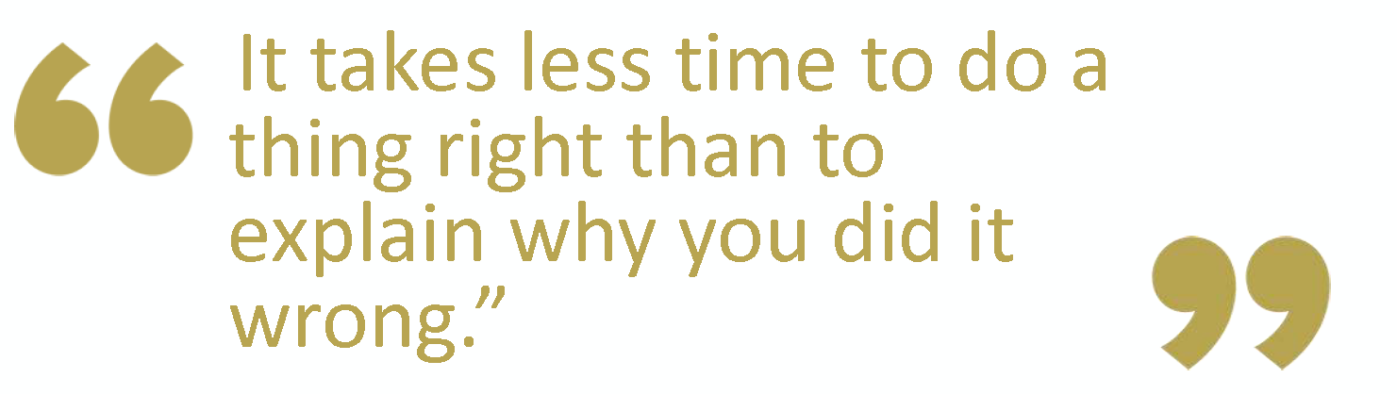
CONSCIENTIOUS
C-STYLE QUOTE:

Slide 127
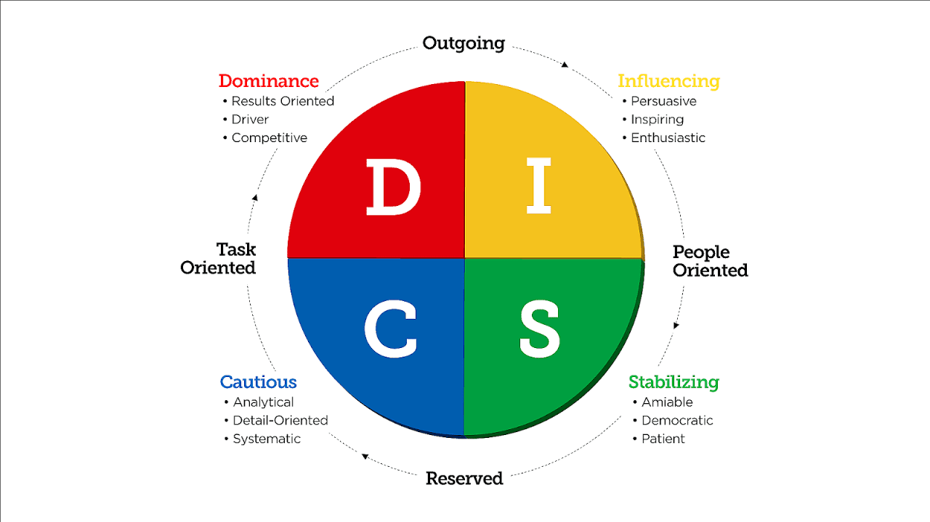
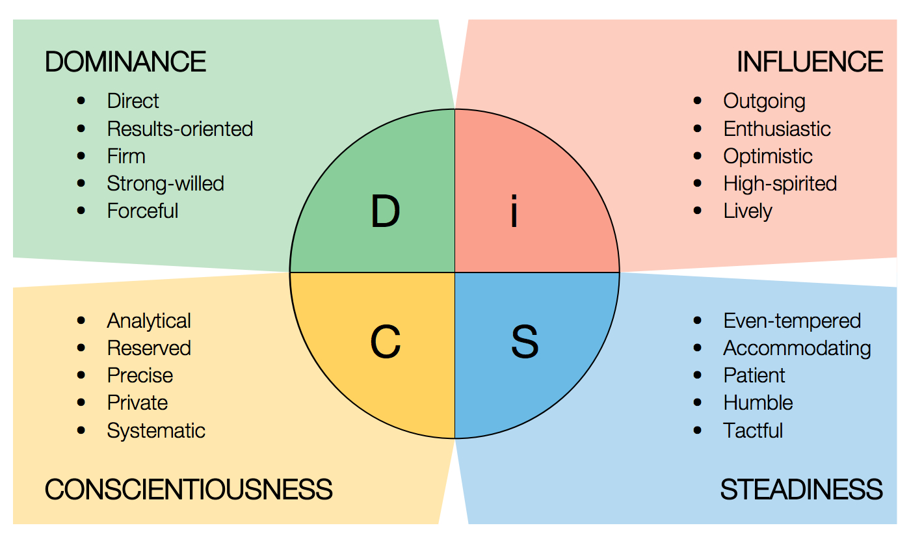
Notes:
We are all combinations of each style
No DiSC style is “better” than any other, and we all use each of the four styles as we go about our daily lives. DiSC simply helps us find out which style we tend to gravitate toward most — our comfort zone. With that knowledge, we can understand our underlying tendencies and preferences and adapt our behaviors to interact with others more effectively.
Driver
Expressive
Analytical
Amiable

Slide 128
SUMMARY
Welcome & Introduction
Hertz Products & Process
Effective Communication
Mastering Verbal Communication
Mastering Non-verbal Communication
Active Listening Techniques
Effective Questioning Techniques
Digital Communication
Customer Profiling

Slide 129
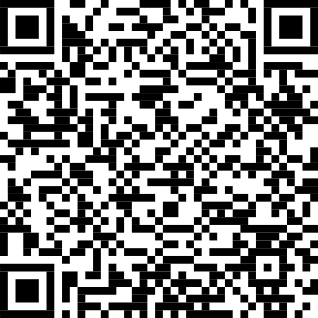
REFERENCE GUIDE

Slide 130
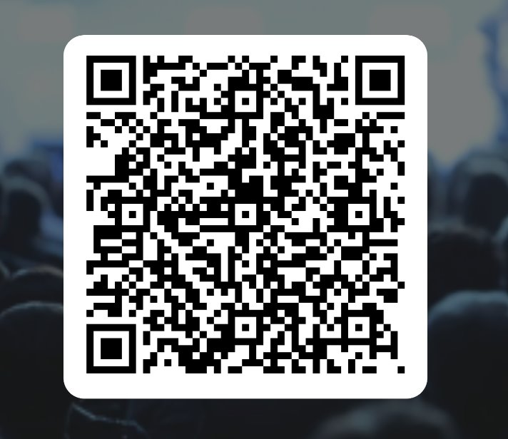
THANK YOU!
HERTZ CUSTOMER COMMUNICATION
Please scan the QR code below to share your feedback

Slide 131
THANK YOU!

